Slide 1
Hawai‘i Health Partners Webinar: Beyond the NICU: Navigating Post-discharge Care for High-risk Infants
Tuesday, February 4, 2025
12:30pm—1:30pm via Zoom
Notes:
Good evening – Thanks for coming and attending this evening’s webinar

Slide 2
Webinar Information
You have been automatically muted
You cannot unmute yourself
You will be able to submit questions via the Q&A section
As a friendly reminder, per 2025 HQIP measure, “HHP Network Engagement”, this webinar counts for HQIP credit

Slide 3


Slide 4
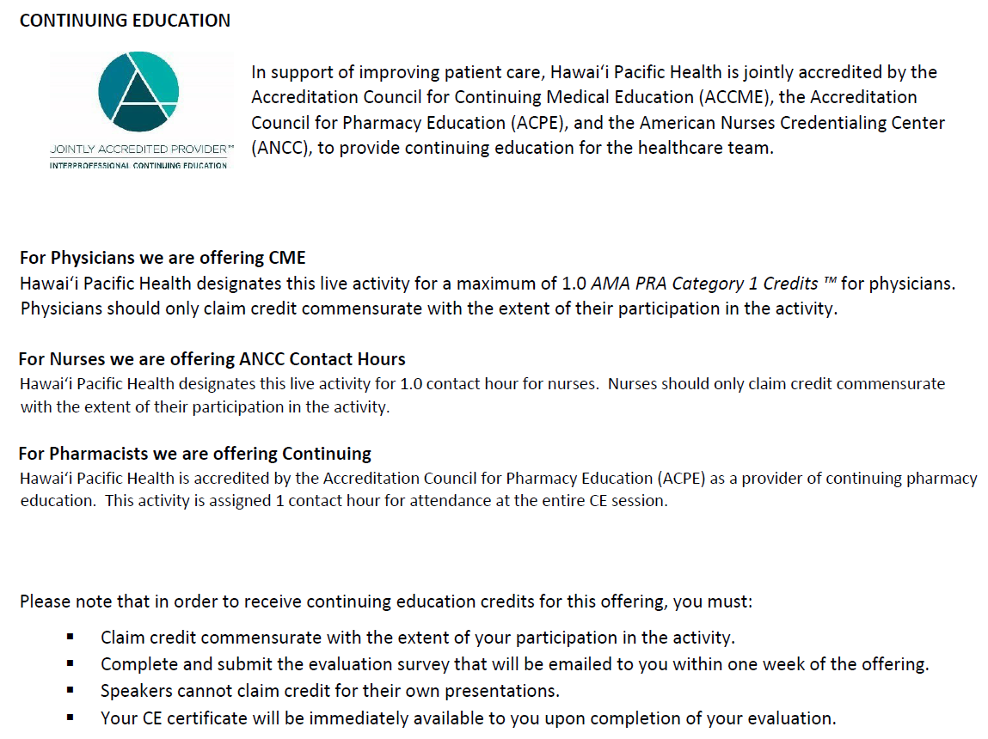

Slide 5
Disclosures
Except as noted below, the planners and presenters of this activity report no relationships with companies whose products or services (may) pertain to the subject matter of this meeting:

Slide 6

Beyond the NICU: Navigating Post-discharge Care for High-risk Infants

Slide 7
Objectives
Identify high-risk infants who require ongoing medical support after the NICU discharge
Discuss common ongoing medical issues and neurodevelopmental outcomes of premature infants
Discuss collaboration between community providers and NICU follow-up program

Slide 8
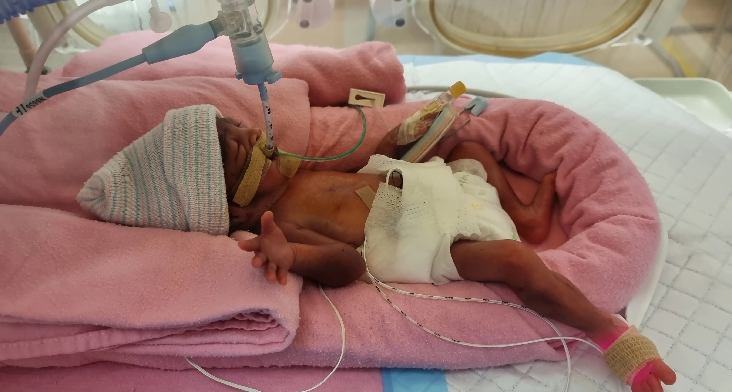
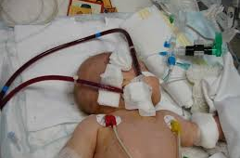
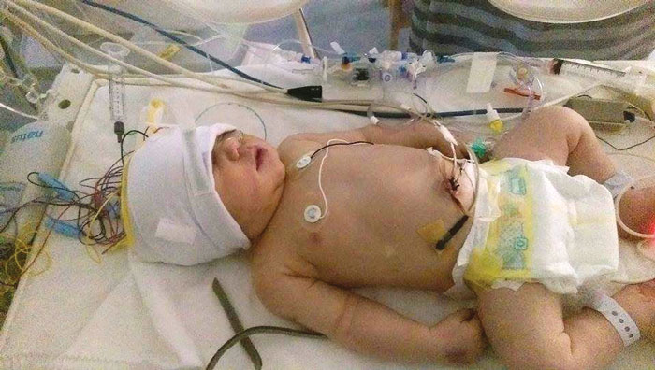
Neonatology 2025
Increasing complexity
Younger, smaller: 22 wks GA, <500g BW
Increased diagnostic testing capabilities
Expanding therapies
Advancing technology
Non-invasive ventilatory strategies
ECMO
Therapeutic hypothermia
Expanding Multi-disciplinary Team
9 ancillary services
10 Medical consultant services
6 Surgical consultant services

Slide 9
KMCWC Outcomes* - 2023
VLBW (<1500g BW) = 137 Very preterm (<30 weeks GA) = 85 | KMCWC 2023
Survival | 137 | 87.3%
Survival without morbidities | 88 | 56.1%
Median Length of Stay | 58 days (39-257)
Preterm Discharged >40 wks corrected GA | 73 | 7%
<10th% wt at discharge | 49 | 38.5%
Chronic lung disease | 52 | 35.4%
Severe intraventricular hemorrhage | 18 | 5.4%
Necrotizing Enterocolitis | 3 | 0.3%
Severe retinopathy of prematurity | 5 | 3.3%
Total discharged home = 1041 | KMCWC 2023
Median LOS | 13 days
Discharged with O2 | 6 | 0.6%
Gastrostomy | 14 | 1.3%
Home NGT feedings | 27 | 2.6%
Any major surgery | 41 | 3.9%
Hypoxic Ischemic Encephalopathy (cooled) | 29 (18) | 2.7% (62%)
ECMO | 3 | 0.3%
Neonatal Abstinence Syndrome | 8 | 1%
Chromosomal anomaly | 8 | 1%
*Vermont Oxford Network Database (VON)

Slide 10
Discharge Readiness: AAP Statement
​ Infant readiness​
Family and home environment readiness​
Community and health care system readiness
Pediatrics 2008;122;1119

Slide 11
High-risk Infants: AAP
Preterm Infants
Infants with special care needs or dependence of technology
Infants at risk because of family issues
Infants with anticipated early death
Pediatrics 2008;122;1119

Slide 12
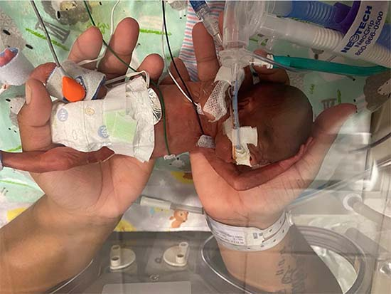
NICU Discharge
Corrected age at discharge
22-27 wks: term+ corrected
28-31 wks: 37-38 wks corrected
32-35 wks: 36 wks corrected
Discharge criteria
Respiratory stability
Temperature regulation
Feeding plan
Growth
Safety

Slide 13
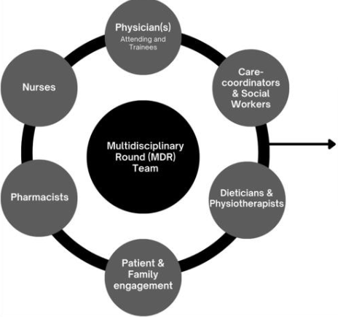
Multi-disciplinary care team approach
Improved coordination of care
Improved patient satisfaction
Improved adherence to treatment plans
Overall staff satisfaction
Improved outcomes
Decreased mortality
Decreased readmissions
Decreased LOS
Increased patient safety
V Srinivas et al, 2023

Slide 14
Multi-disciplinary Pediatric Teams
Cleft craniofacial
Pulmonary hypertension
Palliative care
Oncology
Bronchopulmonary dysplasia
Cochlear implants
Intestinal rehabilitation
Tracheostomy

Slide 15
Post-NICU Multidisciplinary Care
Multi-system involvement
Need for technology/DME
Respiratory/airway: Oxygen, Pulse oximetry, Suctioning, Tracheostomy
NGT/GT, feeding pump
Medications
Lab monitoring
Multiple specialists
Feeding and growth
Dietitian
Speech/feeding team
Neurodevelopmental
Occupational/physical therapists
Audiology
Speech & communication

Slide 16
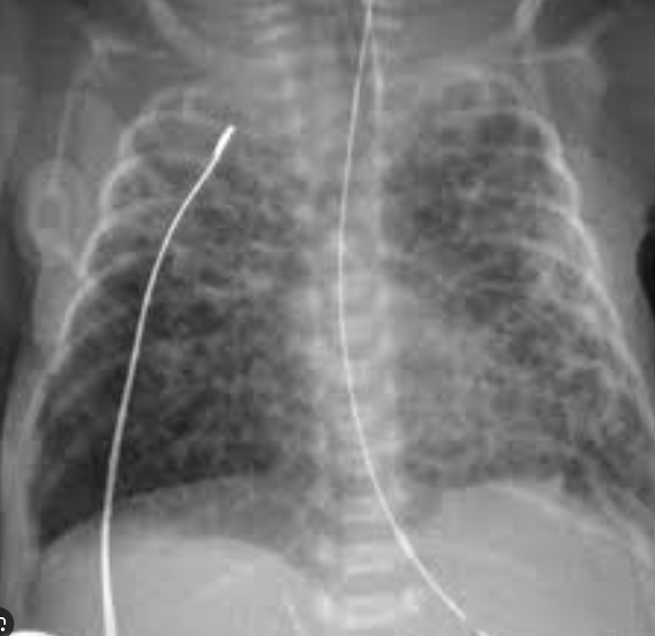
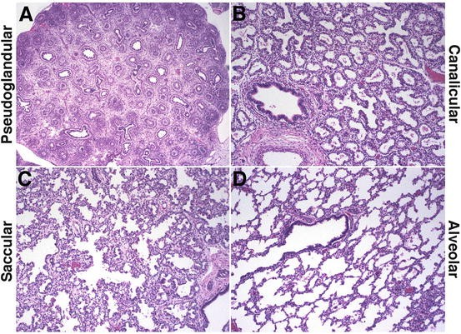
BPD / Chronic lung disease
Definitions
Previously = need for oxygen at 28 days of life
Current =
Need for oxygen at 36 wks corrected gestational age (VON)
Need for positive pressure support at 36 wks corrected gestational age (NICHD)
Overall rate has not changed
Technologic advances
Increasing survival of extremely preterm infants
Multidisciplinary Approach
Inpatient to outpatient
Key to optimizing outcomes
https://encrypted-tbn0.gstatic.com/images?q=tbn:ANd9GcSGaAdQZorAhfIKRnhL_RfMpHdALD6iwKRQYw&s

Slide 17
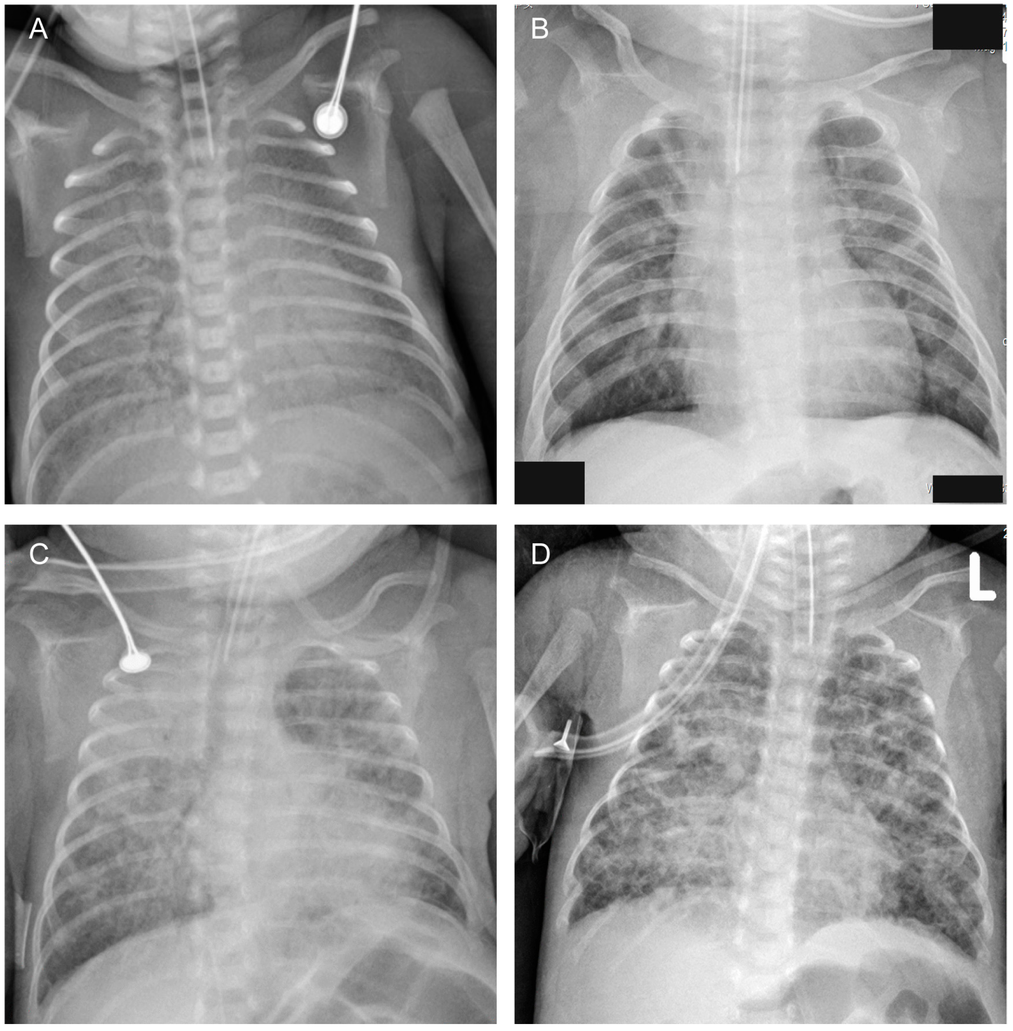
BPD / Chronic Lung Disease
Management
Oxygen
Diuretics
Pulmonology
Multi-system involvement
Feeding: dysphagia, reflux, chronic aspiration
Growth & Nutrition: high caloric needs, metabolic bone disease, cholestasis
Neuro-Developmental
Pulmonary hypertension
Risk of infection

Slide 18
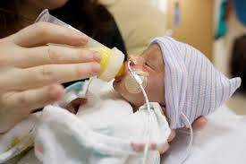
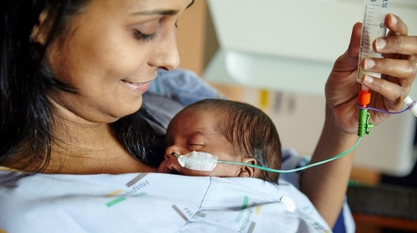
Feeding
Immature suck swallow breathing coordination
Dysphagia
Aspiration
Risk of readmission
Aversion
Speech/feeding team
Special nipples/feeding techniques
Neuromuscular Electrical Stimulation therapy
Home Tube feeding
Nasogastric tube
2020-24 = 123 (25/yr)
Gastrostomy
10/yr

Slide 19
Growth/Nutrition
High caloric and mineral needs
40-50% discharged at <10th percentile for corrected age
2-5% discharged with >20 kcal/oz
Special formulas
Partially hydrolyzed
Milk protein Intolerance
Elemental
NEC/short gut
History of colitis
GE Reflux

Slide 20
Neurodevelopment & Neurosensory
Ophthalmology
ROP screening
Monitoring for amblyopia, strabismus, myopia
Audiology
Late onset hearing loss
Conductive hearing loss
Neurodevelopment
Early Intervention services
Transition to DOE at 3 yrs

Slide 21
PATIENT DISCUSSIONS

Slide 22
Case 1
30 week gestation male, born via vaginal delivery to a 25 year old mother from Kona
Birth weight 1.75kg
Discharged on day 50 of life at 37 weeks corrected age, weight 3.37kg
NICU course
Respiratory insufficiency (NIPPV, CPAP, HFNC). Discharged in room air
Neuro: Grade 1 IVH
Necrotizing enterocolitis
TPN
Hydrolyzed formula for bloody stools – 22kcal/oz
Feeding difficulties
Modified barium swallow study - intermittent stridor, no aspiration
Speech therapy: ultra preemie nipple

Slide 23
Case 1
Discharge needs
Pediatrician
NICU multidisciplinary clinic (30 weeks gestation)
Speech therapy, Dietary
NICU neurodevelopmental clinic (30 weeks gestation)
Did not qualify for Early Intervention Services
Audiology testing at 7 months
RSV prophylaxis
Medications: iron, vitamin D
Feeds: hydrolyzed formula 22kcal/oz

Slide 24
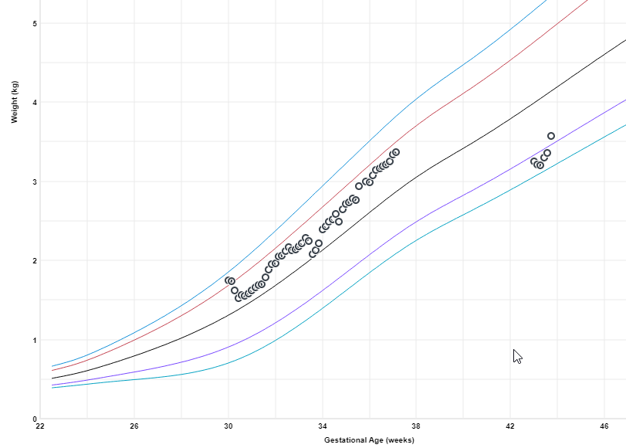
Case 1
NICU Clinic visit
43 weeks corrected age, 91 days of life
Mother mixing formula to 4kcal/oz
Weight loss of 3grams/day since discharge
Weight 3.235kg (3.27kg at discharge)
(7th centile, previously on 85th centile)
Re-admitted for failure to thrive
Monitoring for electrolyte imbalance and re-feeding syndrome
Hyponatremia, metabolic acidosis, hypoalbuminemia
5 day NICU stay

Slide 25
Case 2
23 week gestation neonate, birth weight 0.66kg
4 month NICU stay at 41 weeks corrected age, discharge weight 3.542kg
NICU course
BPD: (Jet ventilator, NIPPV, CPAP, HFNC, LFNC) discharged in room air
Spontaneous intestinal perforation
Resolved cholestasis
PDA post medical closure
Adrenal insufficiency on hydrocortisone supplementation
Grade 2 IVH. Post-hemorrhagic hydrocephalus with VAD placement
Bilateral Stage 1 ROP
Left inguinal hernia repair

Slide 26
Case 2
Discharge needs
Pediatrician
NICU multidisciplinary clinic (<1500g, <30weeks gestation)
Speech therapy, Dietary
NICU neurodevelopmental clinic (<1500g, <30weeks gestation)
Early Intervention Services (<26 weeks gestation)
Pediatric Surgery
Endocrinology: Medication teaching, sick plan
Brain ultrasound & Neurosurgery
ROP evaluation
Audiology testing at 7 months
RSV prophylaxis
Medications: iron, vitamin D, hydrocortisone PO & IM

Slide 27
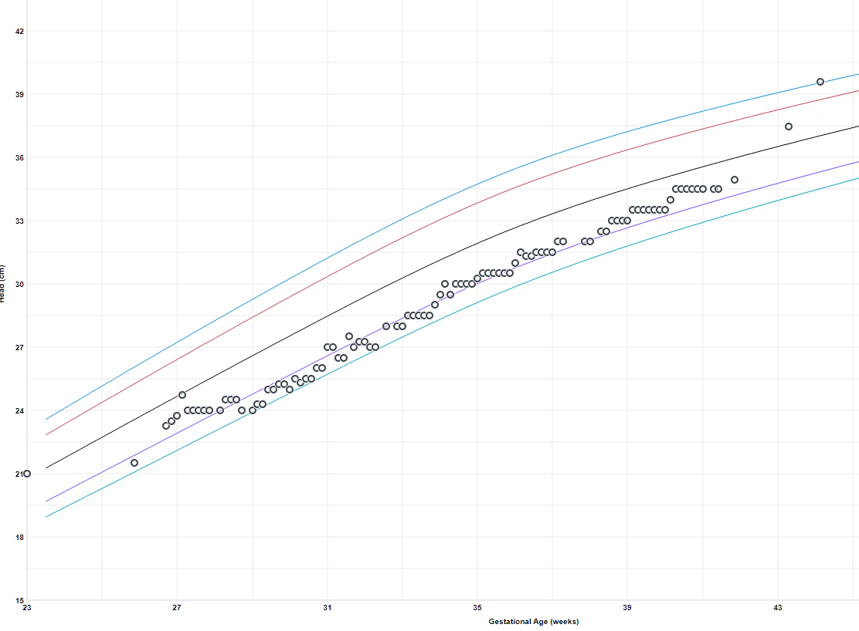
Case 2
NICU Clinic visit
43 weeks corrected age
Interval growth 46grams/day
Breastmilk fortified with preterm formula
24kcal/oz
ASQ (Ages & Stages Questionnaire)
too young
Worsening hydrocephalus
Increasing head circumference
Bulging fontanelle
VAD tap
Neurosurgery consultation
Readmitted to NICU
VP shunt placement
3 day NICU stay

Slide 28
Case 3
38 week gestation, birth weight 2.715kg
Transfer from Kaiser NICU
4 month hospital stay, discharge weight 5.331kg
NICU course
VACTERL, esophageal atresia with tracheal/esophageal fistula, imperforate anus s/p anoplasty
Hemitruncus and tetralogy of fallot s/p repair, PA banding and PDA ligation
Pulmonary hypertension on medications
Feeding difficulty: discharged on nasogastric feeds
75 ml breastmilk bolus feeds over 30 minutes 5 times a day, and continuous feeds at 45 ml/hr x 8 hours overnight
GE reflux
Anemia

Slide 29
Case 3
Discharge needs
Pediatrician
NICU multidisciplinary clinic (complex discharge)
Speech therapy, Dietary (NG feeds)
NICU neurodevelopmental clinic (pulmonary HTN requiring iNO, prolonged mechanical ventilation)
Early Intervention Services (dysphagia)
Pediatric Surgery
Pediatric Cardiology
Audiology testing at 7 months
RSV prophylaxis
Nasogastric tube teaching and supplies
Parental rooming in
Medications: sildenafil, bosentan, iron, vitamin D, omeprazole
Labs: hepatic function panel monthly

Slide 30
Case 3
NICU Clinic visit (2 weeks post-discharge)
Weight loss of 91grams since NICU
Parents noted to be doing continuous nasogastric feeds overnight incorrectly - giving only 45ml total instead of 45ml/hour
Weight checks with Pediatrician
NICU Clinic visit (4 weeks post-discharge)
Weight gain of 20grams per day
6 month Ages & Stages Questionnaire (ASQ)
Communication, Gross motor, Personal-Social, Problem solving: Pass
Fine motor: Follow up
HAST prior to international travel

Slide 31
Post-discharge Care of the High-risk NICU Graduates

Slide 32
Role of PCPs after the NICU Discharge
Up-to-date knowledge and understanding of:
Neonatal technologies and therapies
Drug doses and indications
Laboratory tests that need to be followed
Indications for special formulas and recipes for adjusting calories
Various types of equipment (supplemental oxygen, nasogastric tube, gastrostomy tube [GT], ventriculoperitoneal [VP] shunt, ostomy, pulse oximeter, apnea monitor, tracheostomy, ventilator) and ability to recognize and troubleshoot problems

Slide 33

Neurodevelopmental Outcomes in Preterm Infants

Slide 34
Neurodevelopmental Impairment (NDI)
Intellectual disability or cognitive delay
Cerebral palsy (CP)
Hearing impairment and hearing loss requiring amplification
Severe visual impairment or blindness
Notes:
Neurodevelopmental impairment (NDI) generally refers to cerebral palsy (CP), intellectual disability, severe hearing impairment, and severe visual impairment, and at times it may include severe learning disability, seizure disorder, or hydrocephalus.
Cognitive, neurologic, and/or sensory outcomes
50-70% had impairments in executive functioning, visual motor skills, verbal memory, visual processing, and/or adaptive tasks
Cognitive impairment
Intellectual functioning level and adaptive skills are significant below the average for a child of his chronological age
2 SD below the mean on standardized cognitive tests
Correspond to score of 70 or below on the MDI of Bayley Scales
Rates of cognitive impairments (BSID, MDI <70) ranged from 23 to 40% with means -1 to -2 SDs below the norm in very preterm (<32 weeks) and extremely preterm (<28 weeks) infants

Slide 35
Weeks’ Gestational Age​ | Children With Special Health Care Needs, %​ | Major Neurodevelopmental Disability, %​ | Educational Supports, %​ | Behavioral Disorders, %​
22 ​ | 80 ​ | 70 (52–100) ​ | 75 ​ | ​
23–24 ​ | 80 ​ | 50–60 ​ | 60–70 ​ | 11–23ª ​
25–26 ​ | 60 ​ | 56 ​ | 50–67 ​
27–28 ​ | 50 ​ | 20 ​ | 50 ​ | 20 ​
29–31 ​ | 40 ​ | 15 ​ | 40 ​ | 15 ​
32–36 ​ | 30 ​ | 10 ​ | 25 ​ | 10 ​
≥37 ​ | 20 ​ | 5 ​ | 15 ​ | 5 ​

Slide 36
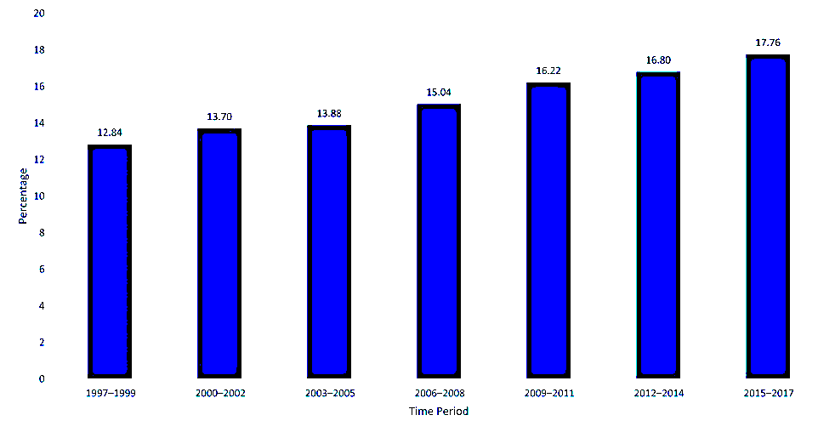
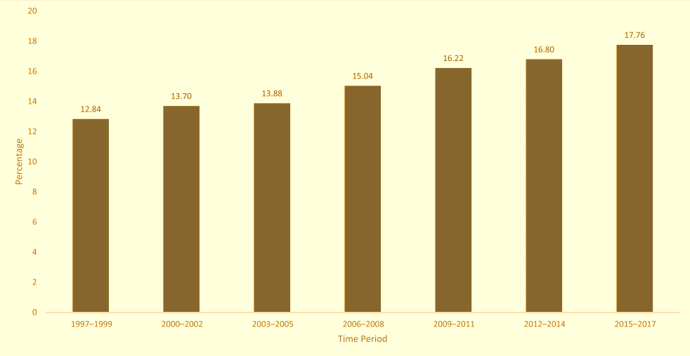
Prevalence of Developmental Disability (DD) among Children Ages 3 to 17 years
Notes:
About 1 in 6 (17%) children aged 3–17 years were diagnosed with a developmental disability
Children 3–17 years diagnosed with a developmental disability increased–from 16.2% in 2009–2011 to 17.8% in 2015–2017
Specifically, diagnoses increased for attention-deficit/hyperactivity disorder (ADHD) (8.5% to 9.5%), autism spectrum disorder (ASD) (1.1% to 2.5%), and intellectual disabilities (ID) (0.9% to 1.2%)
Developmental disabilities are a group of conditions due to an impairment in physical, learning, language, or behavior areas. About one in six children in the U.S. have one or more developmental disabilities or other developmental delays.
Pediatrics published a study that describes how often developmental disabilities were diagnosed among children in the United States, and trends over time. In this study, scientists from the Centers for Disease Control and Prevention (CDC) and the Health Resources and Services Administration (HRSA) found that 17% of children aged 3–17 years had a developmental disability, and importantly, that this percentage increased over the two time periods compared, 2009–2011 and 2015–2017; increases were also seen for specific developmental disabilities in the same age group. Public health officials and healthcare providers can use these findings to better understand the trends associated with the diagnosis of developmental disabilities and to plan for medical, educational, and social services to support children and their families. You can learn more about the report here.external icon
Main Findings:
During the study period (2009–2017)
About 1 in 6 (17%) children aged 3–17 years were diagnosed with a developmental disability, as reported by parents;
In the study population, some groups of children were more likely to have been diagnosed with a developmental disability than others, such as:
Boys compared to girls;
Non-Hispanic white and non-Hispanic black children compared to Hispanic children or non-Hispanic children of other races;
Children living in rural areas compared to children living in urban areas; and
Children with public health insurance compared to uninsured children and children with private insurance.
The percentage of children aged 3–17 years diagnosed with a developmental disability increased–from 16.2% in 2009–2011 to 17.8% in 2015–2017.
Specifically, diagnoses increased for attention-deficit/hyperactivity disorder (ADHD) (8.5% to 9.5%), autism spectrum disorder (ASD) (1.1% to 2.5%), and intellectual disabilities (ID) (0.9% to 1.2%).*
* The reasons for these increases were not examined in the current study, but previous research has found improved awareness, screening, diagnosis, and service accessibility may contribute to the increases seen.
About the Study:
For this study, researchers examined data from the National Health Interview Survey (NHIS), one of the largest in-person household health surveys in the United States. Parent-reported data from 88,530 children aged 3–17 years were included in the study.
Parents were asked whether a doctor or other healthcare provider ever told them their child had any of the following developmental disabilities:
Attention-deficit/hyperactivity disorder
Autism spectrum disorder
Blindness
Cerebral palsy
Moderate-to-profound hearing loss
Learning disability
Intellectual disability
Seizure in the past 12 months
Stuttering or stammering in the past 12 months
Any other developmental delay
If a parent answered “yes” to their child having at least one of these, their child was considered to have a developmental disability. For the study period (2009–2017), this study describes how often developmental disabilities were diagnosed among children in the United States, and trends over time. It also describes how often specific developmental disabilities were diagnosed among these children. The authors also looked at the data according to sex, age, race and ethnicity, health insurance coverage, birthweight, maternal education, federal poverty level, and urbanicity of residence.
Developmental delays, disorders, or disabilities are common among US children and often co-occur
A recent Centers for Disease Control and Prevention (CDC) study found that 17.3% of US children between the ages of 3 and 17 had at least one developmental disability (DD). This is similar to a previously determined rate of 17.8%.¹ This new study also found that 6.7% of US children had two or more DDs.
Children with DD have increased health care and service needs
US children with DD were found to be more likely to have limited abilities, such as limited movement or play abilities, and/or service needs, including special equipment and home health care, than children without a DD. Children with DD were 18 times as likely to utilize services such as special education or early intervention (EI). Children with DD were two to seven times more likely than those without a DD to utilize health-related services such as
Prescription medication
Mental health professionals, medical specialists, or special therapists (occupational, physical)

Slide 37
KMCWC NICU Follow-up Program

Slide 38
NICU Follow-up Program:
NICU Medical Follow-up Clinic
Recently expanded from 1.5 clinic days to Monday – Friday
Telehealth visits: 1 week post-NICU discharge, neighboring island patients
In-person visits: Monday (full day) and Wednesday (half-day)
Neonatologist, NNPs, neonatal hospitalists, dieticians, and OT/SLP
NICU Neurodevelopmental Clinic
Collaboration with OT/PT, and Developmental Pediatrics
Pediatric Pulmonary Hypertension Team Clinic
Inter-disciplinary team: Neonatology, Pediatric Critical Care, Pediatric Cardiology and Pediatric Pulmonology

Slide 39
NICU Clinic: Eligibility
VLBW, very preterm infants
≤1500g BW, ≤30 wks GA
BPD, home oxygen therapy
Intraventricular hemorrhage (≥ gr II) or intracranial bleeding
Ventricular assisted device (VAD) or VP shunt
Hypoxic ischemic encephalopathy (HIE), hypothermia therapy
Neurological disorders
Seizures, PVL, neural tube defects, abnormal muscle tone
Post-surgical cardiac repair
ECMO, pulmonary hypertension, requirement of PHNT medications
Growth failure
Dysphagia, feeding difficulty, GERD
Requirement of home tube feedings (NG, GT, or GJ)
Ongoing medical issues
Cholestasis, metabolic bone disease
Hx of exchange transfusion, high GIR
Complex discharge and transition to community providers

Slide 40
NICU Clinic: Services
Medical management and care coordination: telehealth and in-person visits
Ongoing medical issues after discharge
Assist with transition to home environment
Growth monitoring and management of nutrition needs
Care-coordination with multi-disciplinary teams
Transition to appropriate long-term subspecialty care clinics
Neonatal and Perinatal consultation
Joint prenatal consultation with Palliative Care Team
Early neurodevelopmental screening
Ages & Stages Questionnaires (ASQ) 3 and Bayley IV Scales of Infant Development
RSV prophylaxis to high-risk infants

Slide 41
Other Multi-disciplinary Clinics
Rehabilitation therapy: OT/PT/SLP
Complex care
Cleft/craniofacial
Gastrointestinal /Intestinal Rehab
Cardiology
Pulmonology
Neurology
Physiatry
Developmental Pediatrics

Slide 42
NICU Medical Clinic: 2023
Visits
Individual patients seen | 251
Initial post hospitalization | 225
Return visits | 146
Total visits | 371
Patients seen per month | 31
Visits per patient | 1.7 (range 1-8)
Patients with 4 or more visits | 17 (7%)
Total NICU graduates | 1041
VLBW discharged | 137
ELGANs | 43
>30 weeks GA | 114

Slide 43
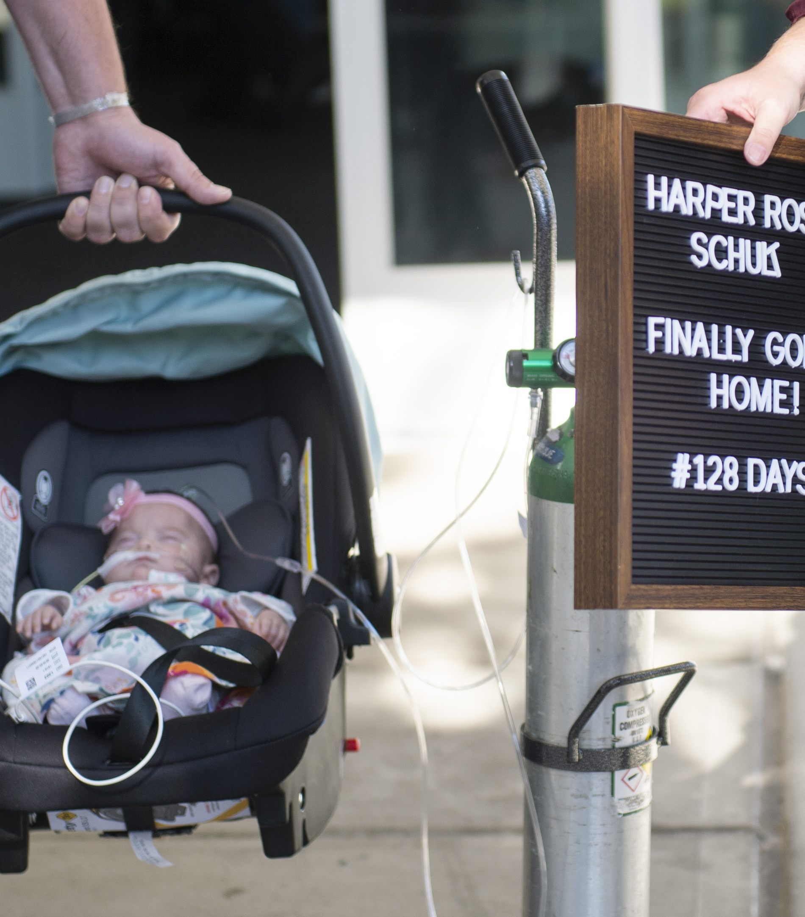

Thank you

Slide 44

Next HHP Webinar: (for HQIP credit)
^{March Webinar – TBA}
^{Topic – Dr. Hatch-Pigott}
To view upcoming HHP webinars and future events, please visit our Hawai‘i Health Partners website for the “Events Calendar” from the “For Providers” dropdown.
Notes:
Abdominal Aortic Aneurysm

Slide 45
Thank you for joining us!
A recording of the meeting will be available afterwards
Unanswered question?
Contact us at info@hawaiihealthpartners.org
Notes:
Finally, we thank you for your time this evening and for the tremendous amount of work that you have done over the last year to take care of our community. If you have additional questions, please reach out to us a

