Slide 1
Hawai‘i Health Partners Webinar: Atrial Fibrillation
Thursday, June 12, 2025
12:30pm—1:30pm via Zoom
Notes:
Good evening – Thanks for coming and attending this evening’s webinar

Slide 2
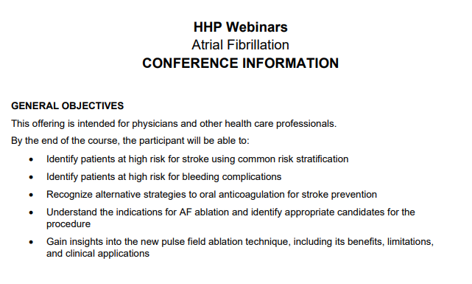
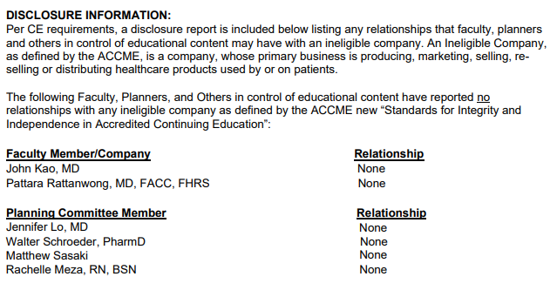

Slide 3
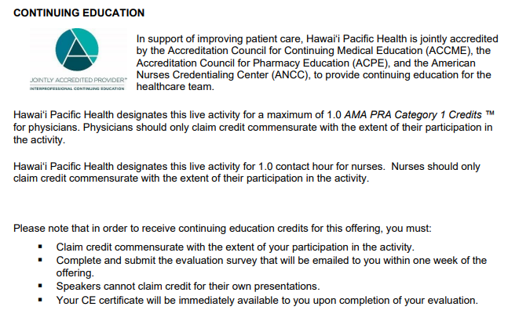

Slide 4
Webinar Information
You have been automatically muted
You cannot unmute yourself
You will be able to submit questions via the Q&A section
This webinar counts for credit in the 2025 HQIP measure HHP Network Engagement - Webinars

Slide 5
Disclosures
None

Slide 6
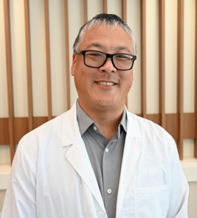
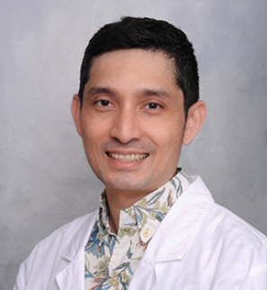
Hawai‘i Health Partners Webinar: Atrial Fibrillation
John Kao, MD
Hawai‘i Pacific Health Medical Group
Pattara Rattanawong, MD, FACC, FHRS
Cardiac Electrophysiologist Director of EP lab and Sport/Genetic EP Clinic
Pali Momi Medical Center | Hawai‘i Pacific Health
Research Collaborator | Mayo Clinic

Slide 7
LAAO as an Alternative to Oral Anticoagulation
John Kao, MD
Hawai‘i Pacific Health Medical Group

Slide 8
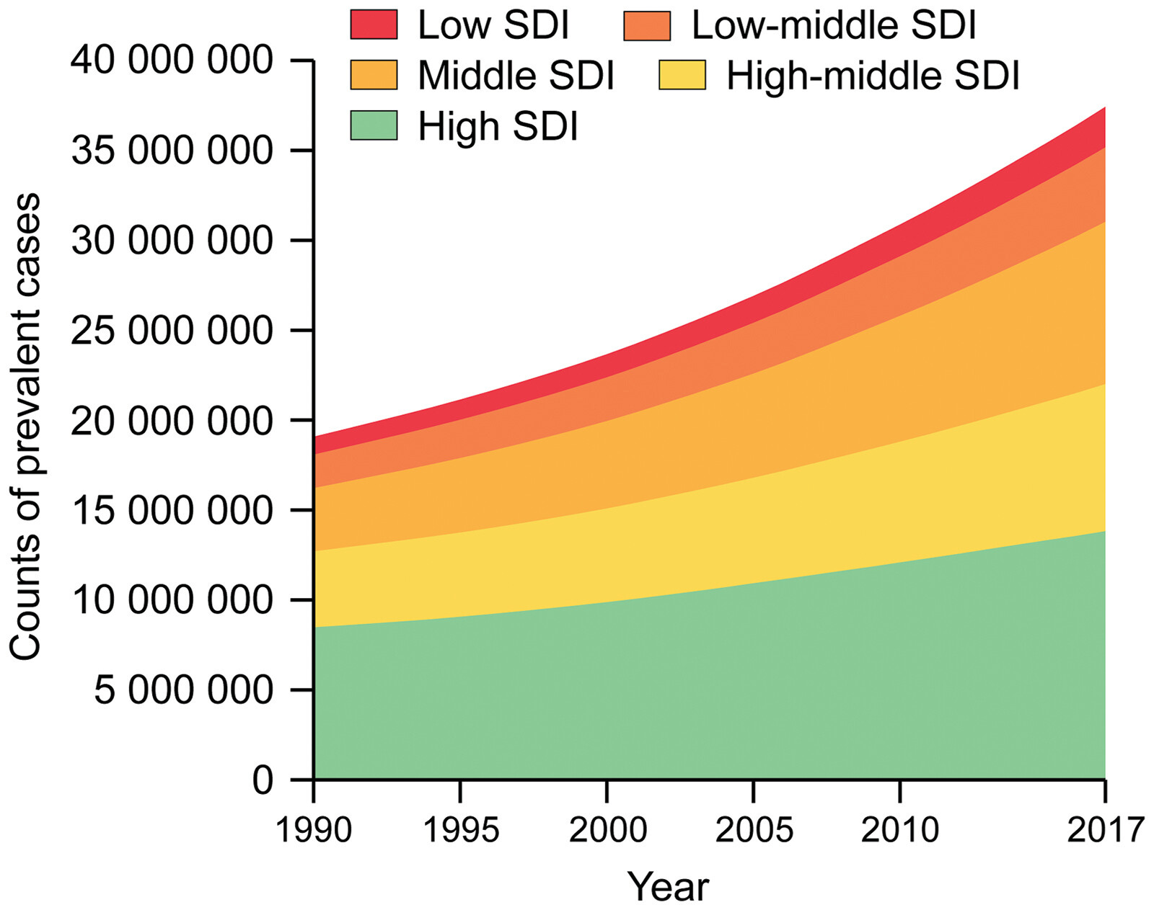

Social Demographic Index as Risk for Afib
1990-2017
Three factors assessed
Income per capita
Education level age > 15 y/o
Total fertility rate < 25 y/o
© 2023 by the American College of Cardiology Foundation and the American Heart Association, Inc.
José A. Joglar. Circulation. 2023 ACC/AHA/ACCP/HRS Guideline for the Diagnosis and Management of Atrial Fibrillation: A Report of the American College of Cardiology/American Heart Association Joint Committee on Clinical Practice Guidelines, Volume: 149, Issue: 1, Pages: e1-e156, DOI: (10.1161/CIR.0000000000001193)

Slide 9
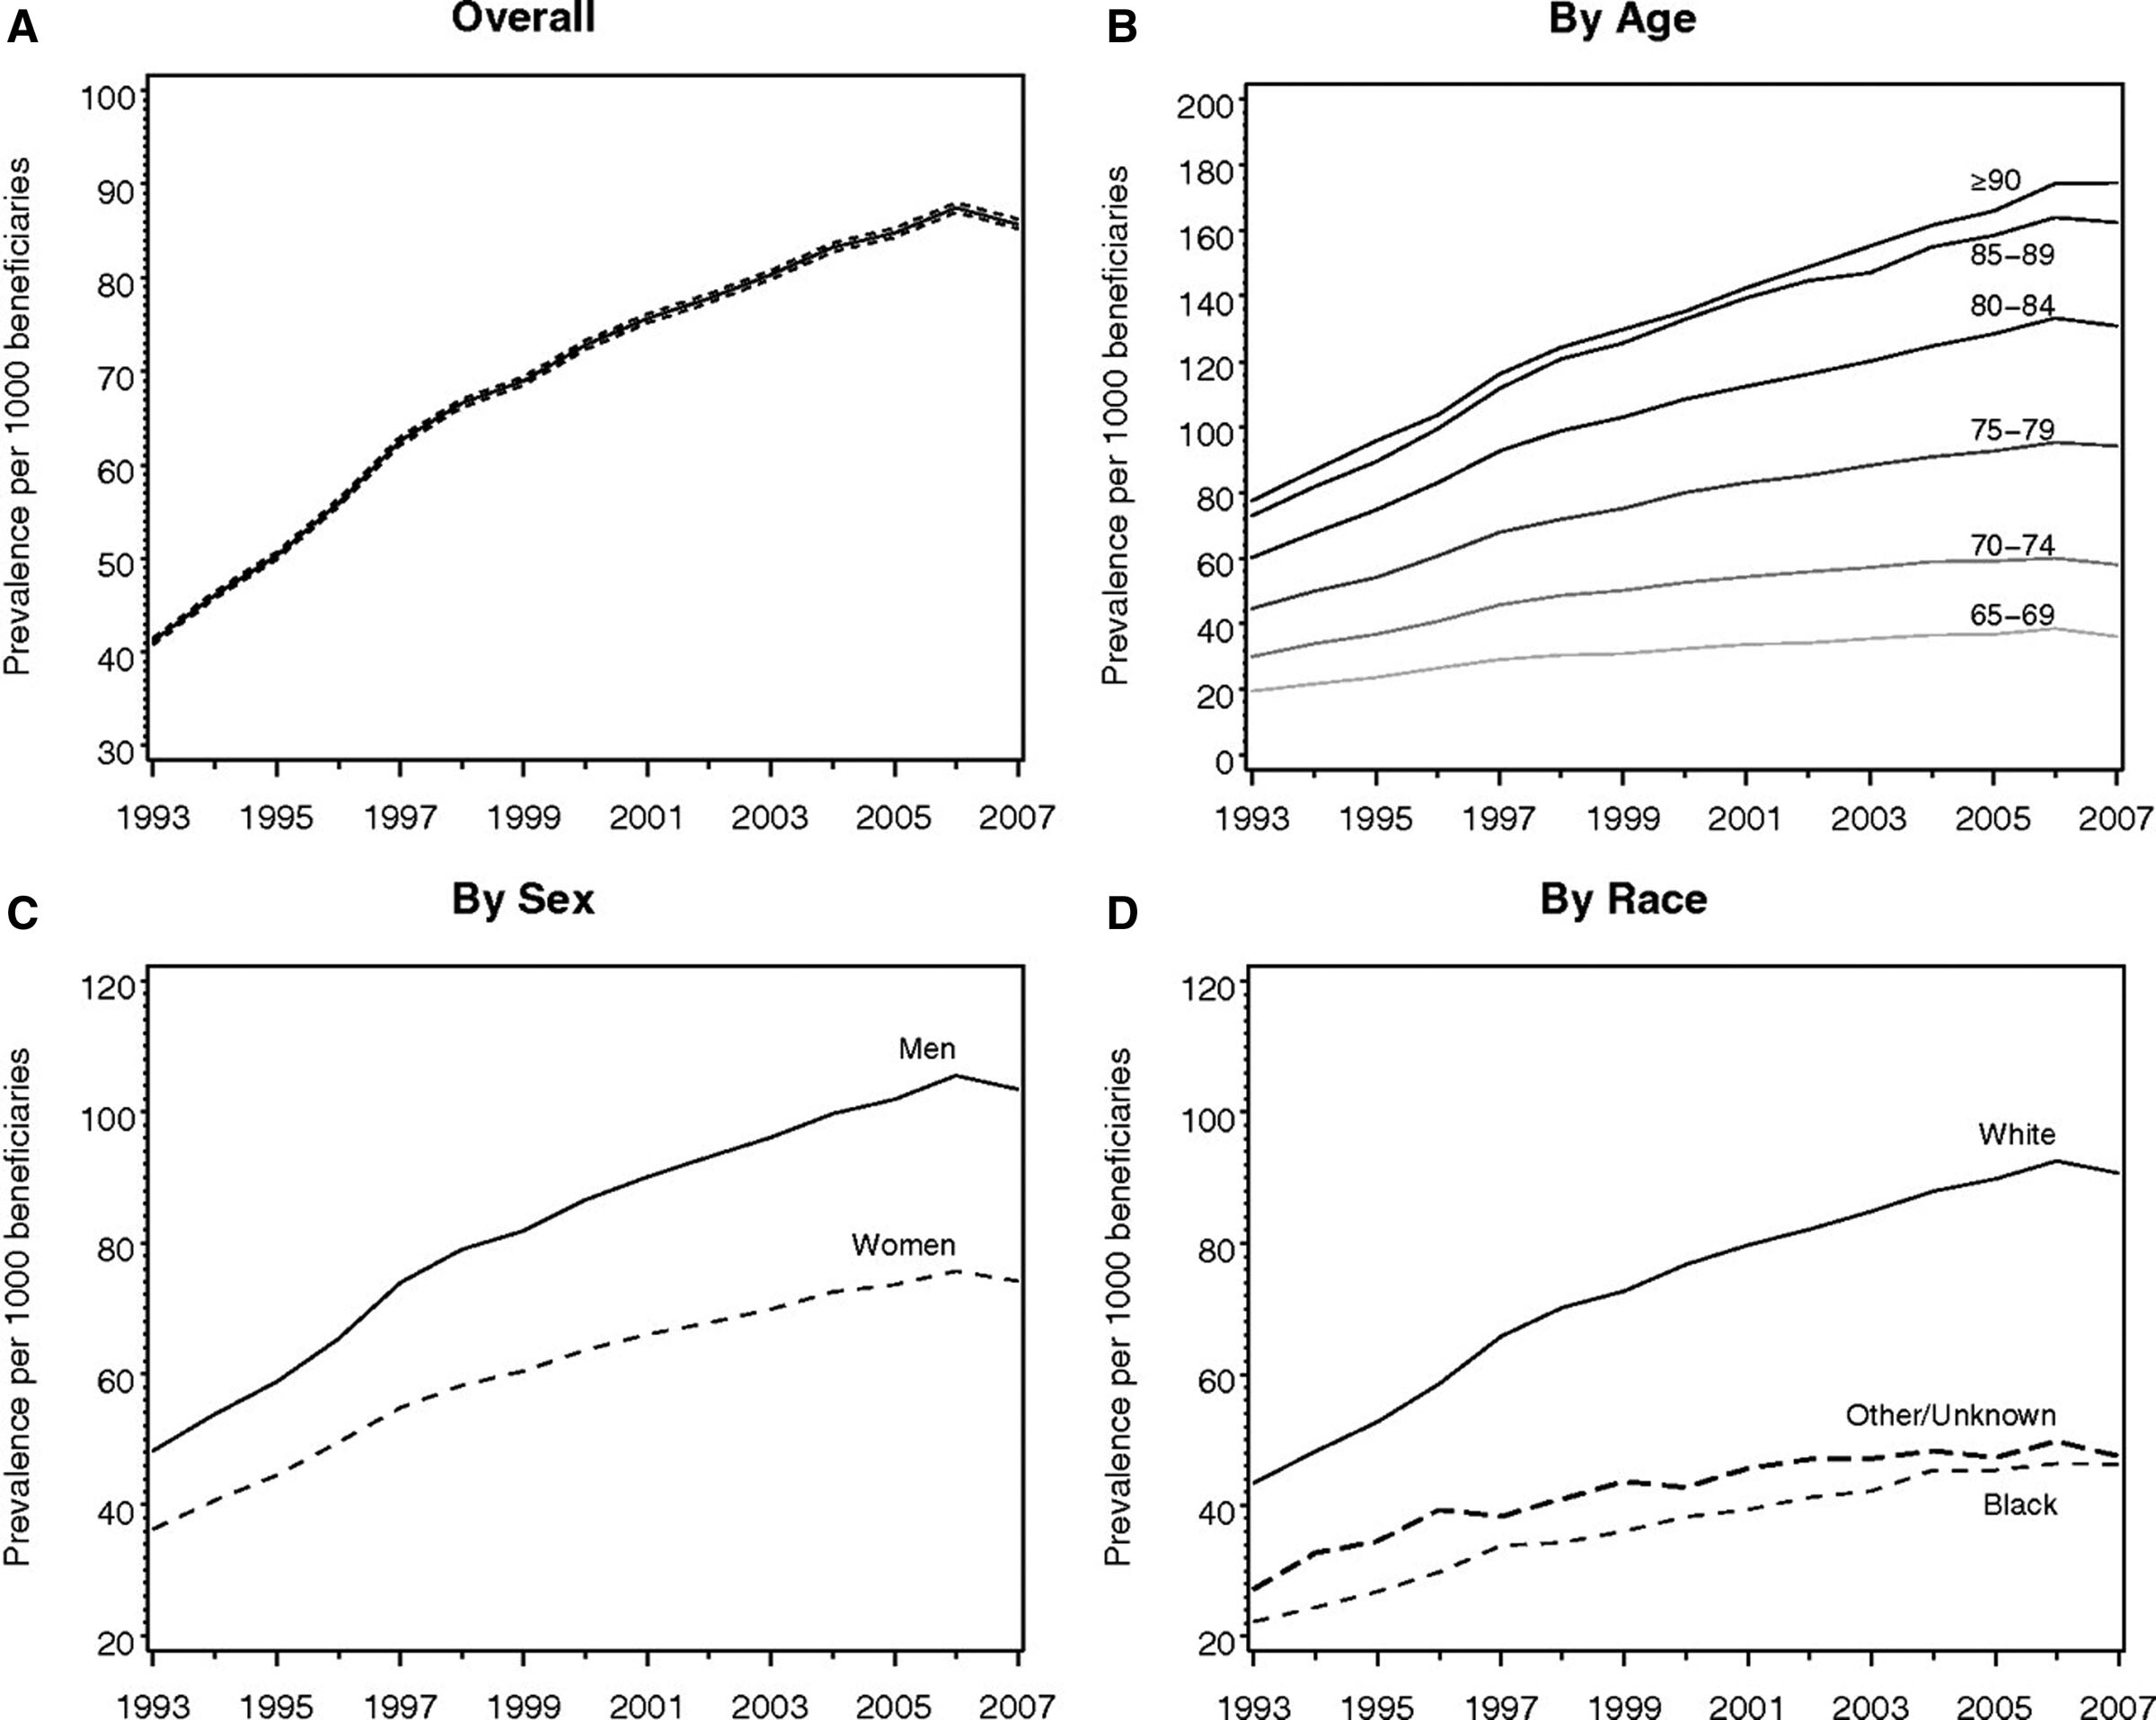
Afib among Medicare beneficiaries 1993-2007
© 2023 by the American College of Cardiology Foundation and the American Heart Association, Inc.
José A. Joglar. Circulation. 2023 ACC/AHA/ACCP/HRS Guideline for the Diagnosis and Management of Atrial Fibrillation: A Report of the American College of Cardiology/American Heart Association Joint Committee on Clinical Practice Guidelines, Volume: 149, Issue: 1, Pages: e1-e156, DOI: (10.1161/CIR.0000000000001193)

Slide 10
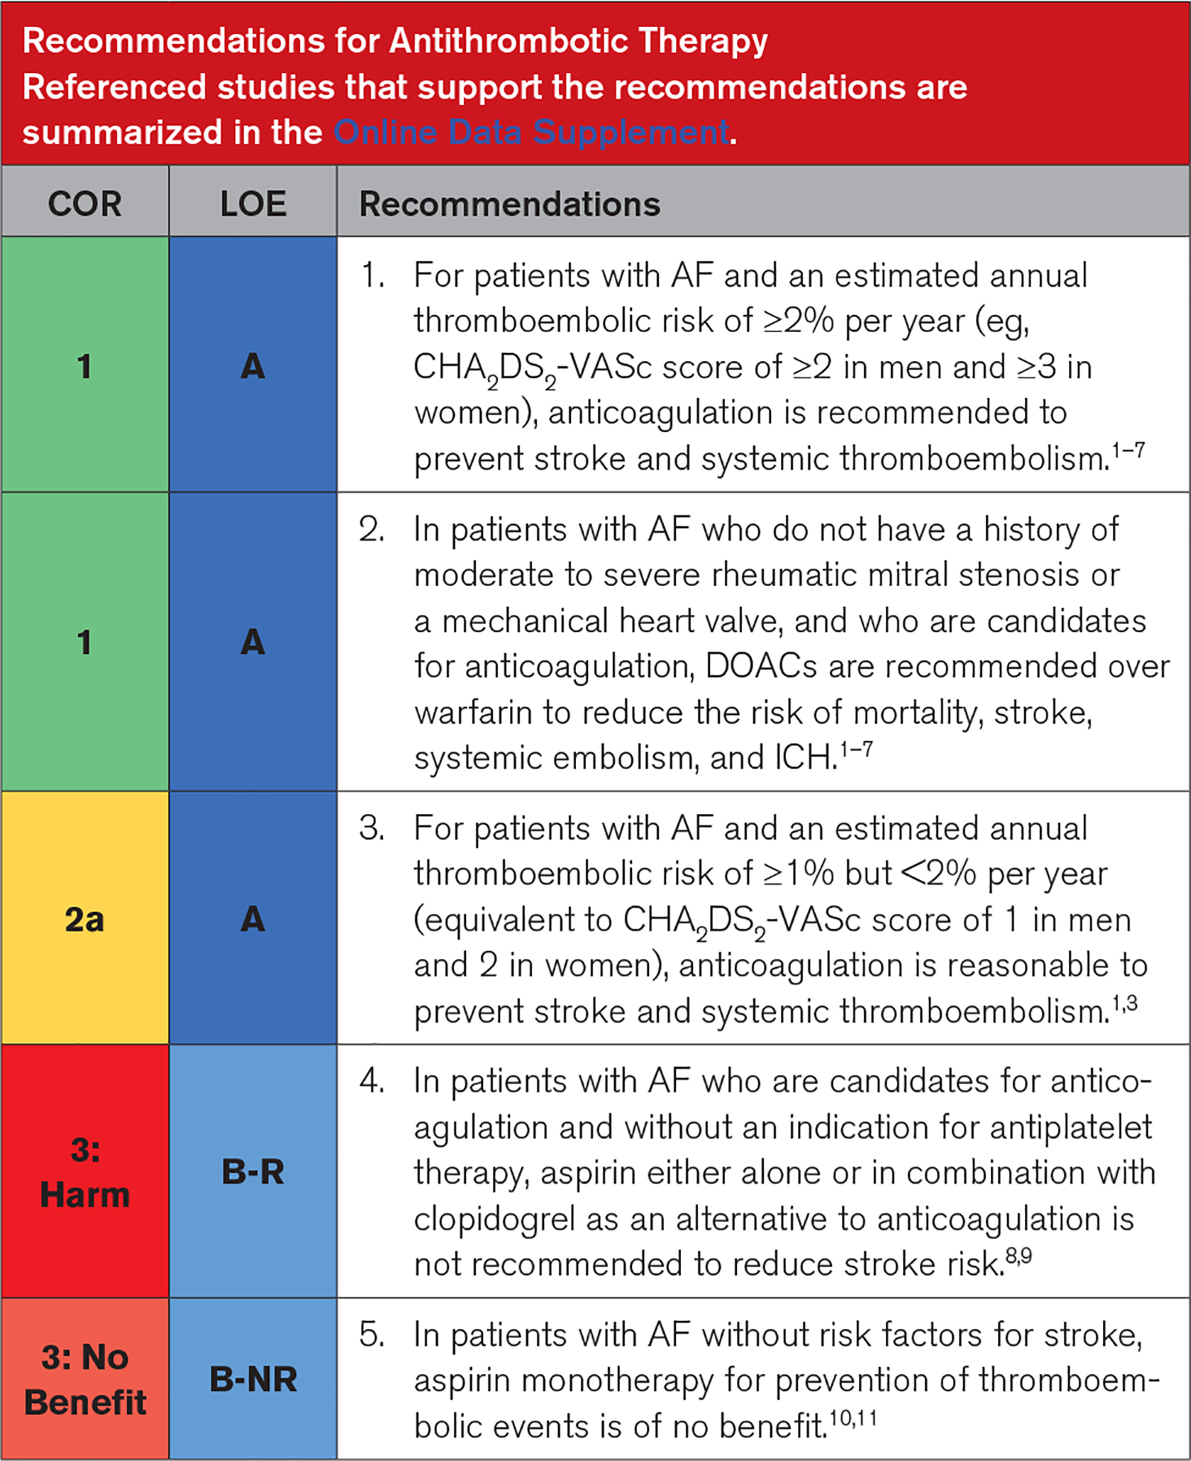
2023 ACC/AHA/ACCP/HRS Guideline for the Diagnosis and Management of Atrial Fibrillation

Slide 11
Risk Calculators
CHADS2Vasc
Congestive Heart Failure/LV dysfunction
Hypertension
Age
Diabetes Mellitus
Stroke/TIA or Thromboembolism
Vascular Disease
Gender
Score 0 to 9 (0-15.2% annual risk for stroke)
HAS-BLED
HTN > 160 mmHg
Abnormal renal function
Abnormal liver function
Age
Prior stroke
Prior major bleed or predisposition
Labile INR (<60% at target)
On drugs that predispose bleeding
Alcohol use
Score 0- 9 (0.6 - 1.13% to 4.9 -19.6% 1 year risk major bleed on OAC)

Slide 12
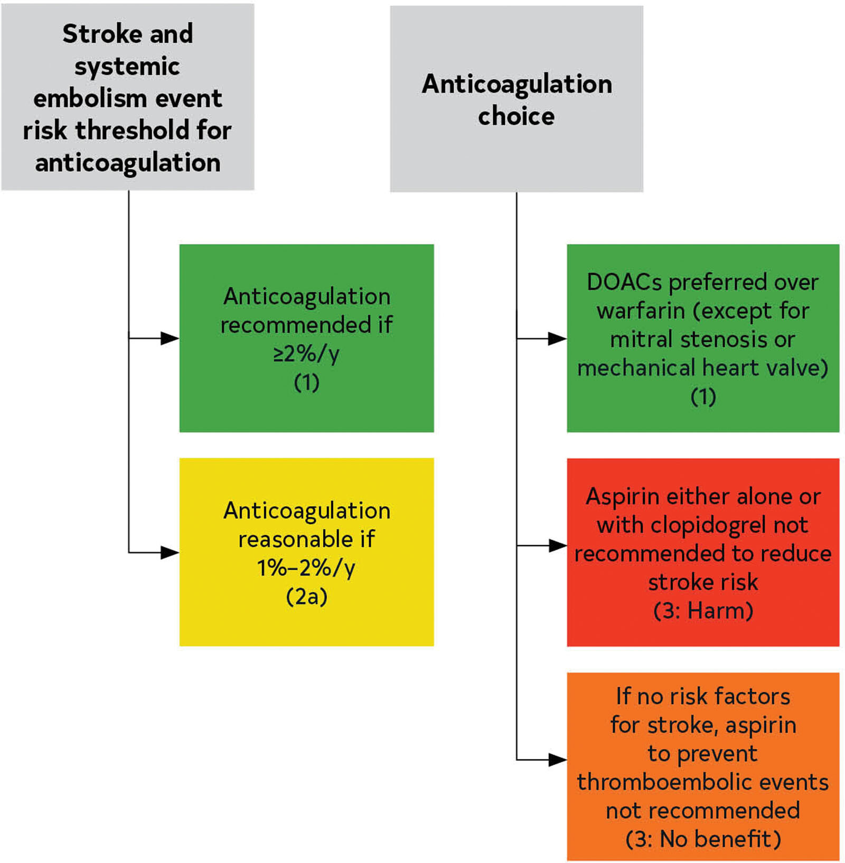
© 2023 by the American College of Cardiology Foundation and the American Heart Association, Inc.
José A. Joglar. Circulation. 2023 ACC/AHA/ACCP/HRS Guideline for the Diagnosis and Management of Atrial Fibrillation: A Report of the American College of Cardiology/American Heart Association Joint Committee on Clinical Practice Guidelines, Volume: 149, Issue: 1, Pages: e1-e156, DOI: (10.1161/CIR.0000000000001193)

Slide 13
Pt is a 77 y/o man with diagnosis of PAF, CVA and had a severe GIB requiring hospitalization.
Pt Jehovah’s Witness, refusing blood transfusion
HTN
Normal renal function, liver function, LVEF normal
CHADS2Vasc score – 5, High risk 6.7% annual risk for stroke
HAS-BLED score – 4, High risk 4.9-19.6% annual major bleed risk on OAC

Slide 14


Slide 15
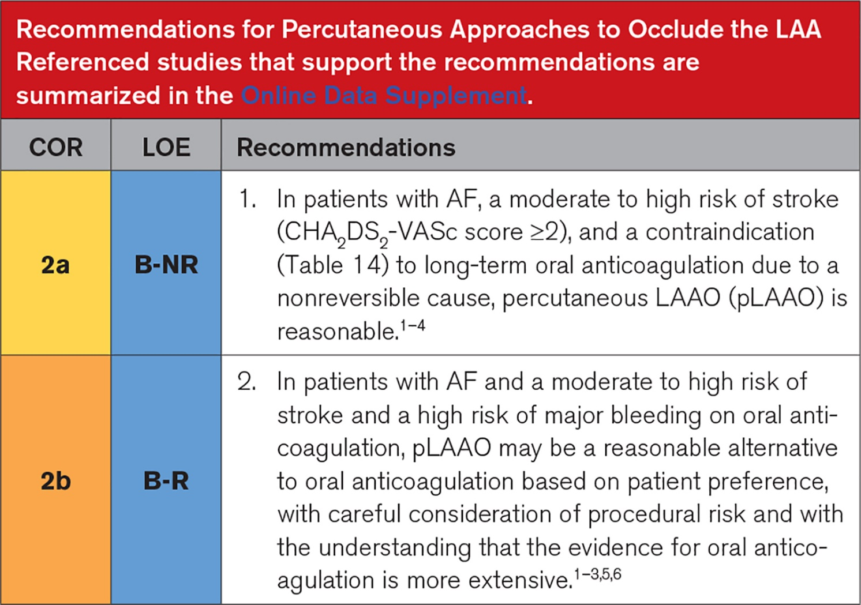
LAAO as an alternative to OAC
2023 ACC/AHA/ACCP/HRS Guideline for the Diagnosis and Management of Atrial Fibrillation

Slide 16
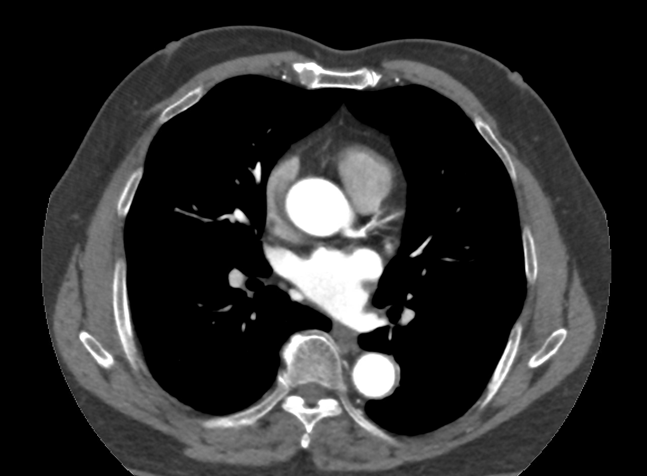
Left Atrial Appendage

Slide 17
LAAO as an alternative to OAC
PROTECT-AF Trial – Holmes et al. The Lancet. Aug 15, 2009. Volume 374, 534-542.
LAAO with Watchman vs Warfarin therapy non inferior for composite endpoint of stroke/cardiovascular death/systemic embolism
Amplatzer IDE Study – Lakkireddy et al. Circulation. August 2021. Volume 144 (19)
LAAO occlusion with Amulet vs. Watchman non inferior safety and effectiveness
Amulet with superior compared to Watchman for complete sealing of the appendage
Amulet had a higher procedure related complication rate compared to Watchman which decreased with operator experience

Slide 18
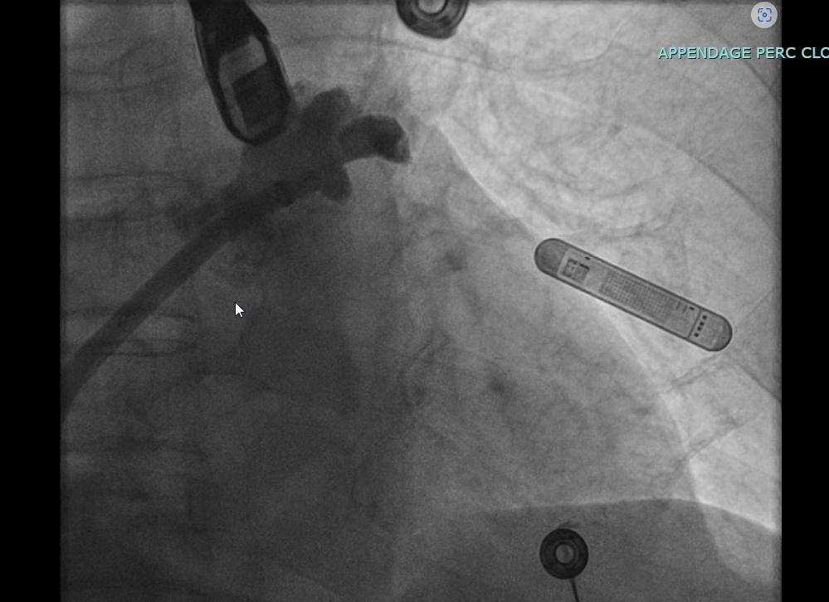

Slide 19
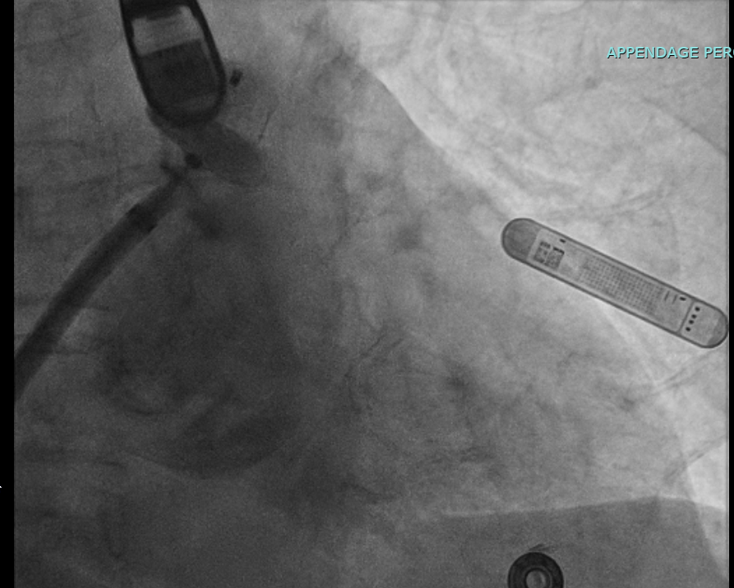

Slide 20
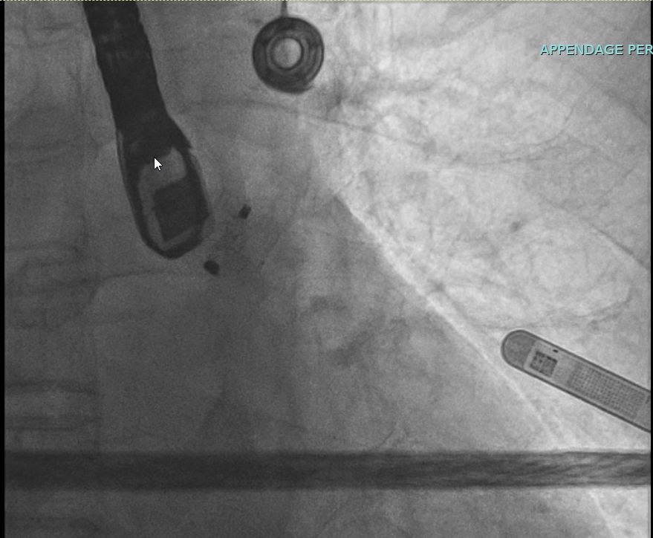

Slide 21
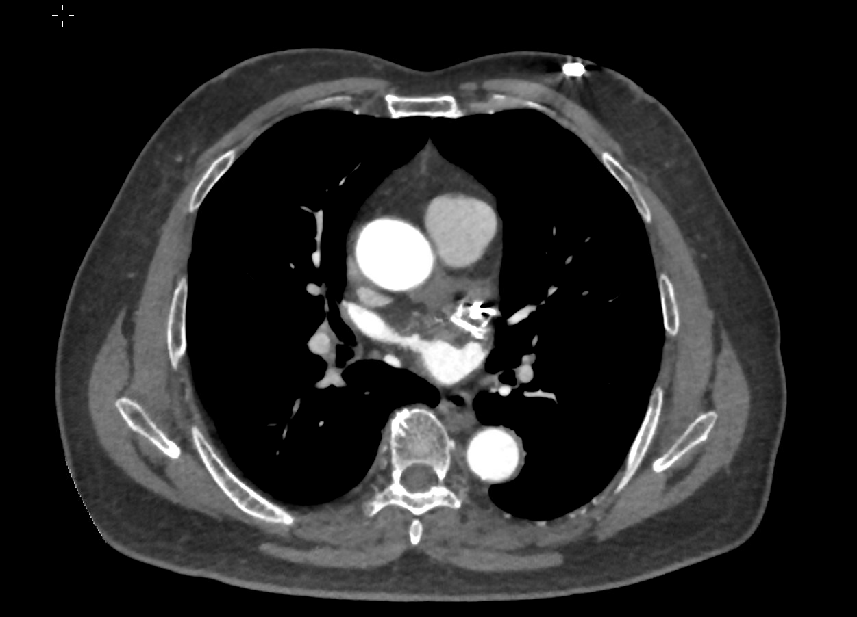
s/p LAAO

Slide 22
Pt seen in clinic post CT, doing well no complications
Plan for total 6 months DAPT then asa after

Slide 23
LAAO has been a successful alternative to OAC in appropriate patients
Procedure is done both at Straub (Watchman) and Pali Momi (Amulet)
Data from long term follow up studies demonstrate continued safety and efficacy of both devices

Slide 24
AF Ablation
Pattara Rattanawong, MD, FACC, FHRS
Cardiac Electrophysiologist Director of EP lab and Sport/Genetic EP Clinic
Pali Momi Medical Center | Hawai‘i Pacific Health
Research Collaborator | Mayo Clinic

Slide 25
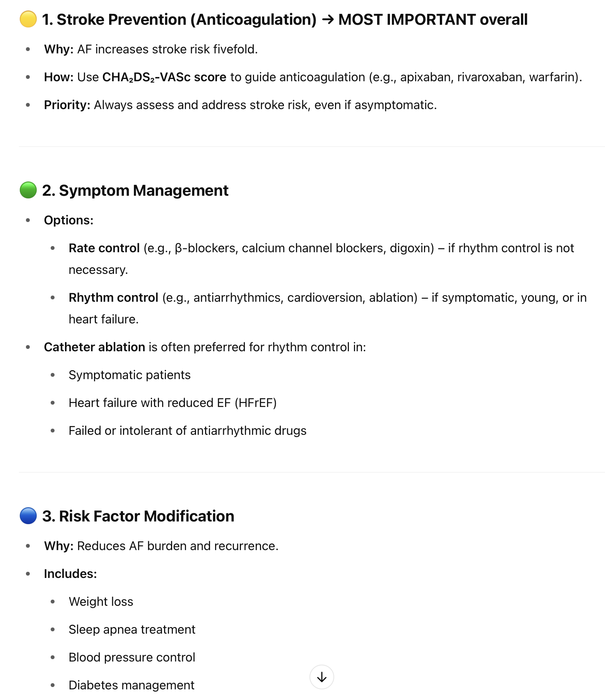

What is the most important management of AF?

Slide 26
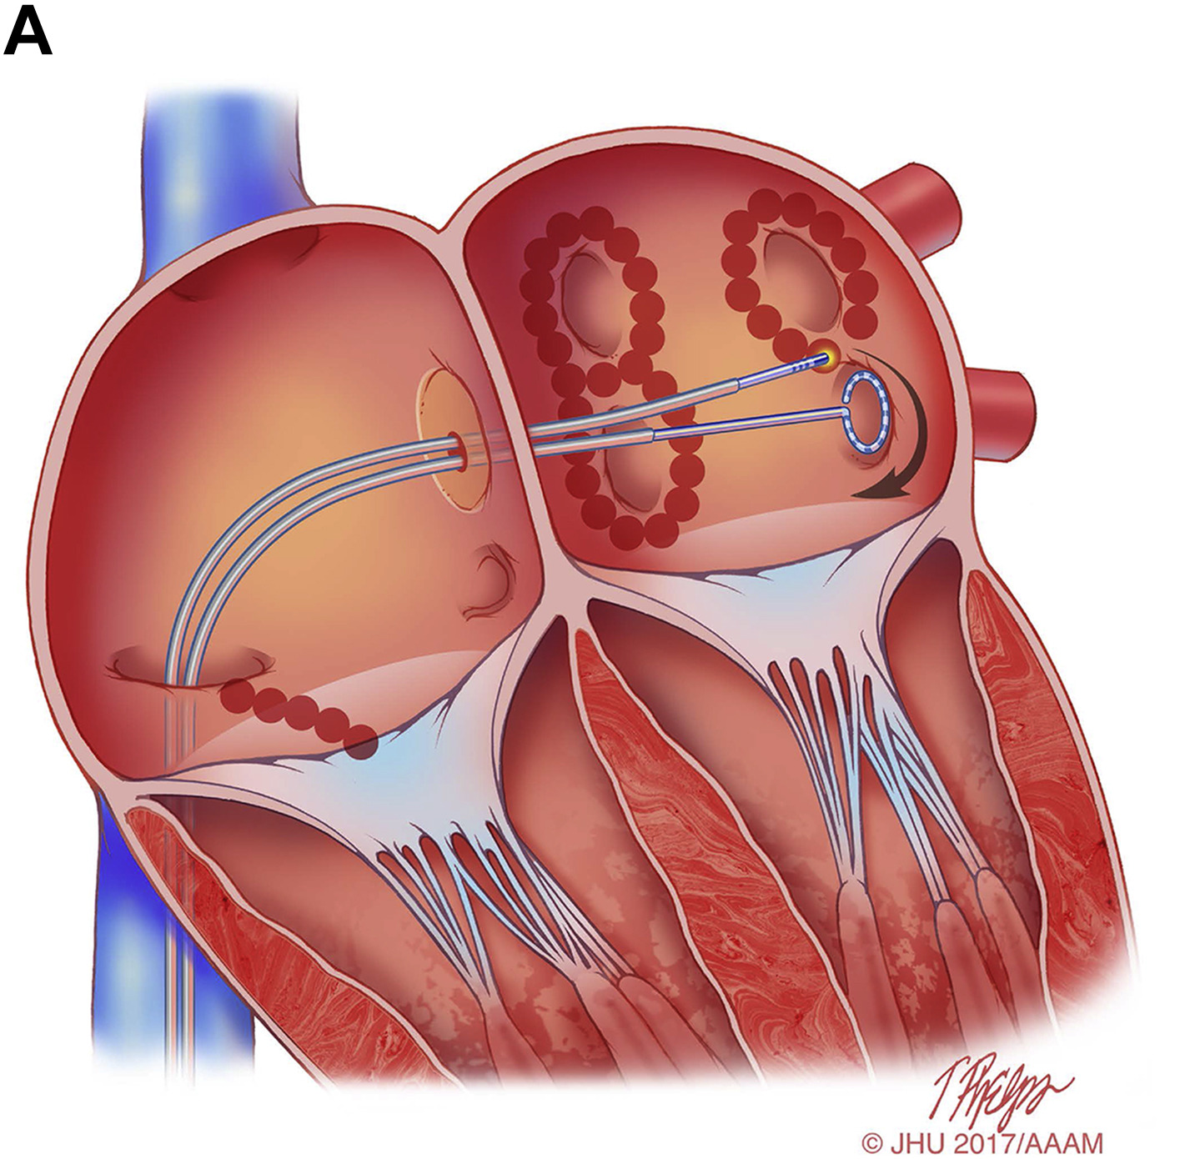
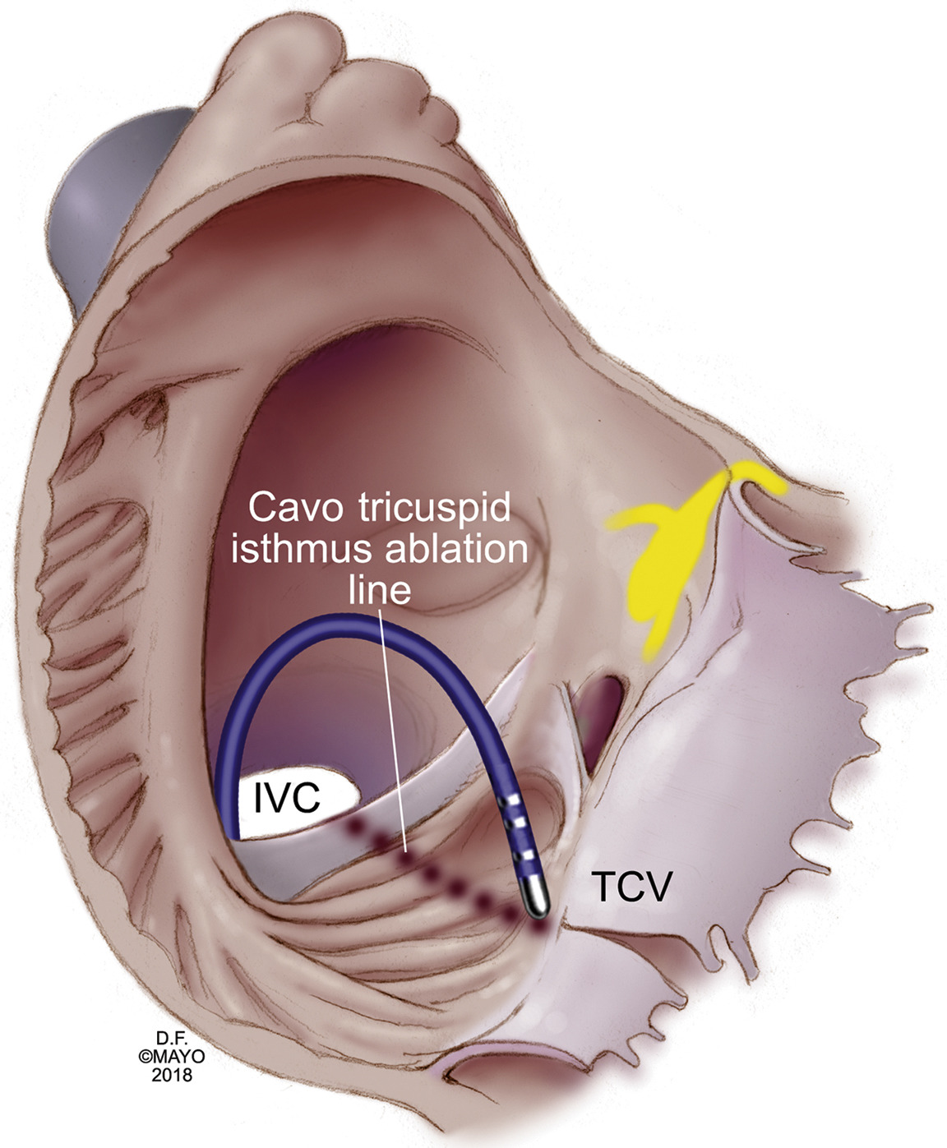
AF/Atypical AFL | Typical AFL
NOT CURE | CURE

Slide 27
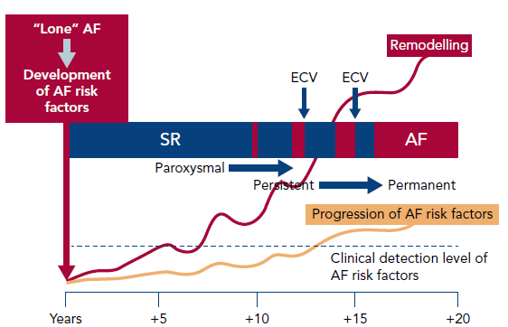
80%
70%
50%
Wyse DG, Van Gelder IC, Ellinor PT, Go AS, Kalman JM, Narayan SM, Nattel S, Schotten U, Rienstra M. Lone atrial fibrillation: does it exist? J Am Coll Cardiol. 2014 May 6;63(17):1715-23. doi: 10.1016/j.jacc.2014.01.023.

Slide 28
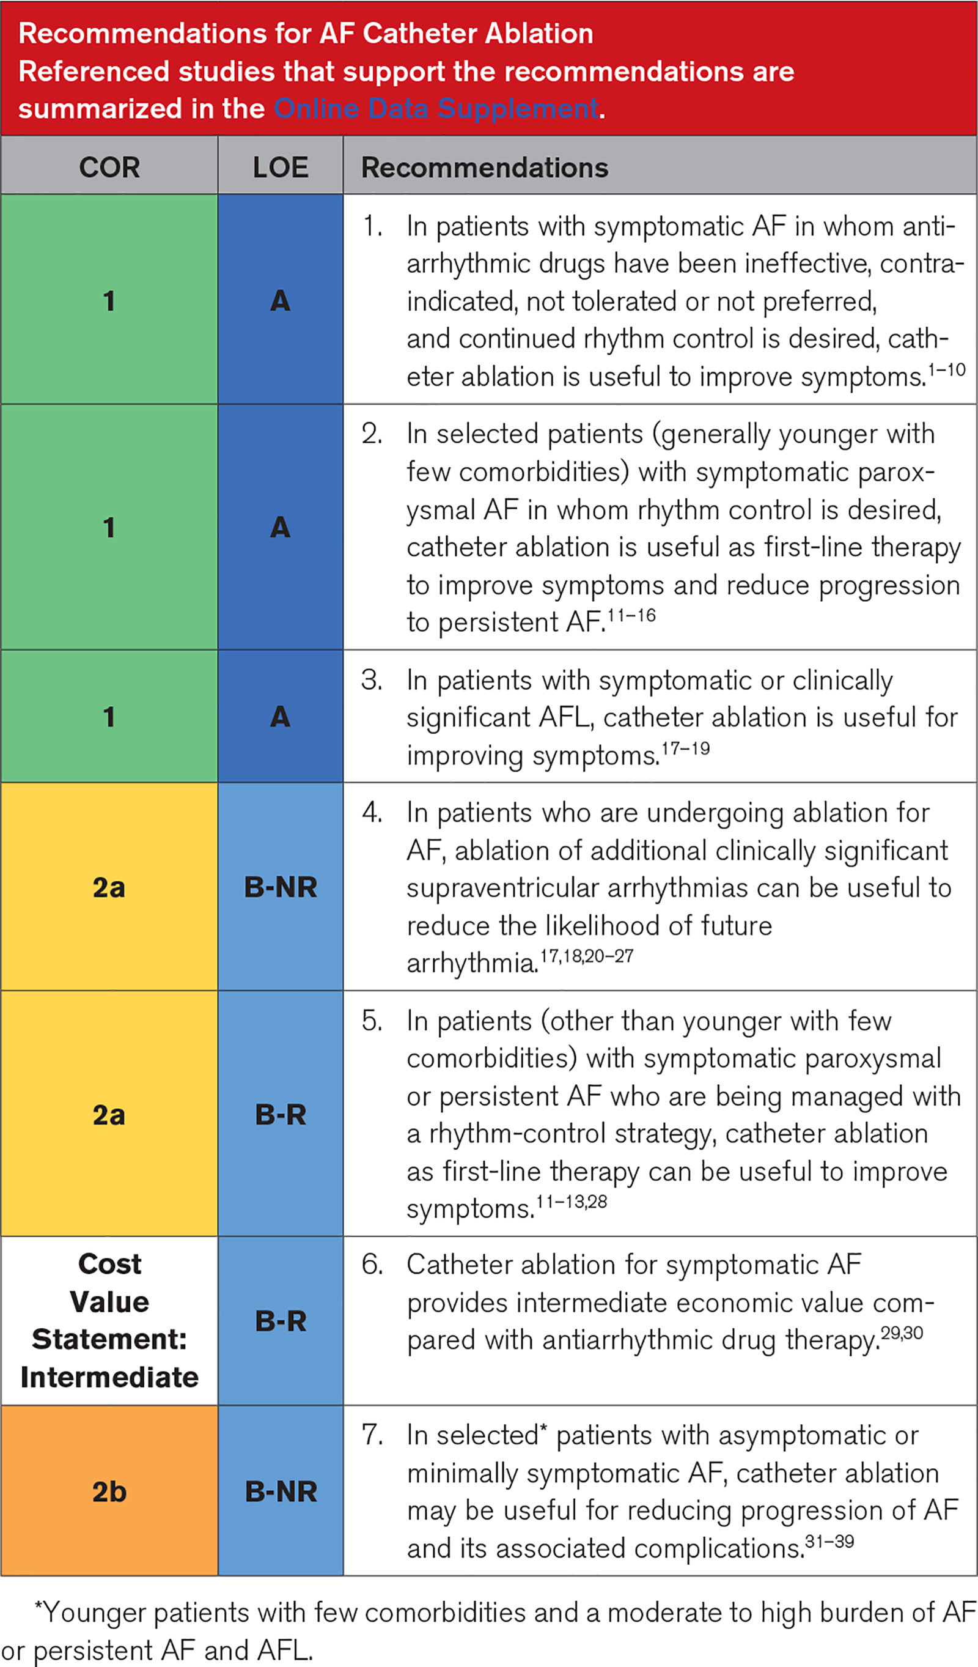
Joglar JA et al. 2023 ACC/AHA/ACCP/HRS Guideline for the Diagnosis and Management of Atrial Fibrillation: A Report of the American College of Cardiology/American Heart Association Joint Committee on Clinical Practice Guidelines. Circulation. 2024 Jan 2;149(1):e1-e156.

Slide 29
Trial | Year | Population | Finding
SPHERE | 2024 | PAF and PeAF | PFA noninferior to RF
ADVENT | 2023 | PAF | PFA noninferior to RF
STOP-AF FIRST | 2021 | Drug-naïve PAF | Lower AF recurrence with cryoablation
EARLY-AF | 2020 | Drug-naïve PAF | Ablation superior to AADs for rhythm control
EAST-AFNET 4 | 2020 | Early AF (<1 yr) | Early rhythm control reduced CV events
ATTEST | 2019 | PAF | Ablation delays AF progression

Slide 30
AF Ablation
Radiofrequency
Cryoballoon
Pulse-field ablation

Slide 31
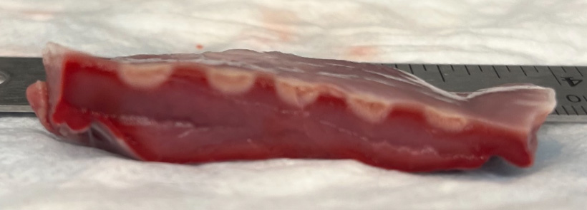
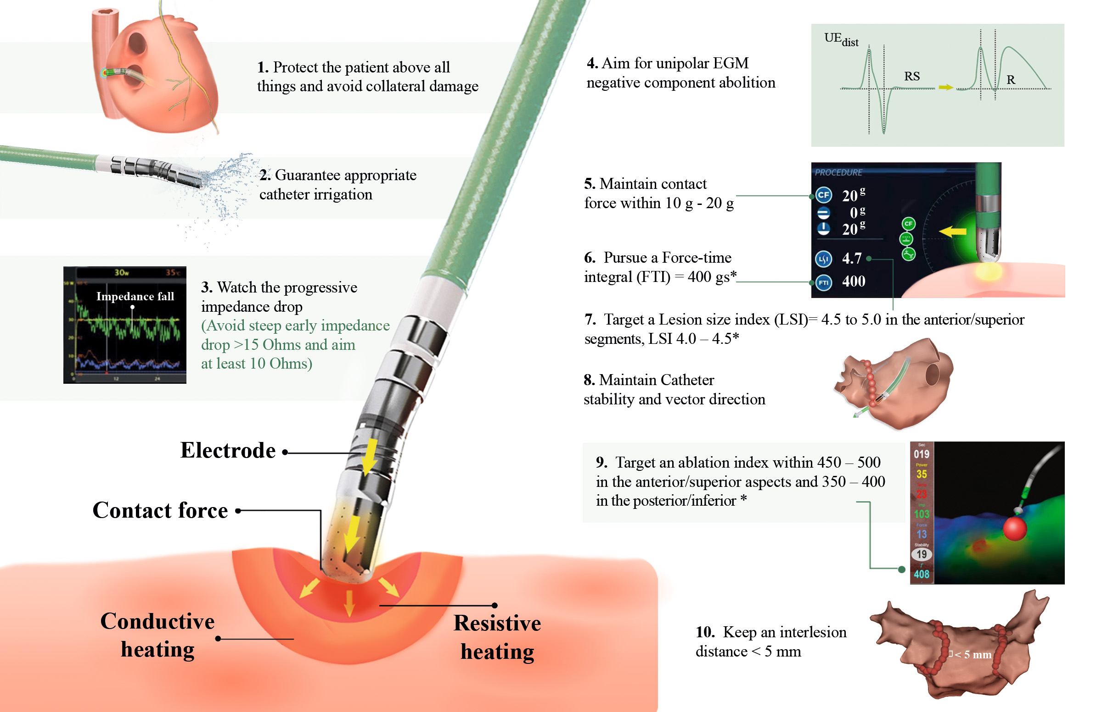
Radiofrequency ablation
Ely Gracia et al. Understanding Lesion Creation Biophysics and Improved Lesion Assessment during Radiofrequency Catheter Ablation. The Perfect Combination to Achieve Durable Lesions in Atrial Fibrillation Ablation. Rev. Cardiovasc. Med. 2024, 25(2), 44.

Slide 32
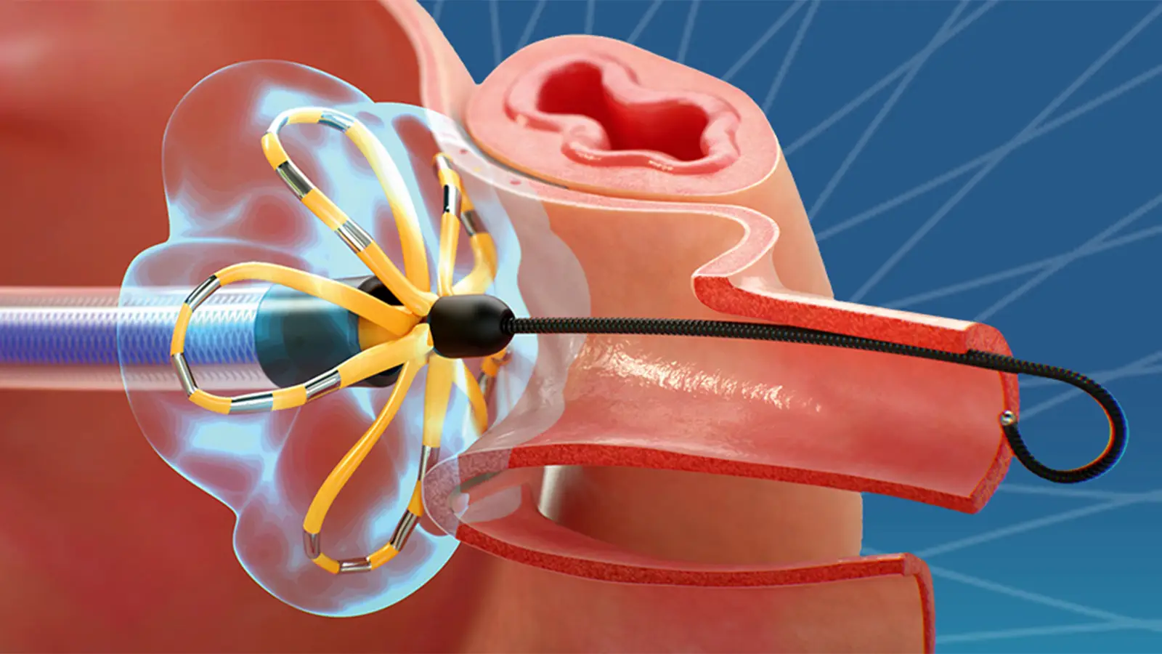
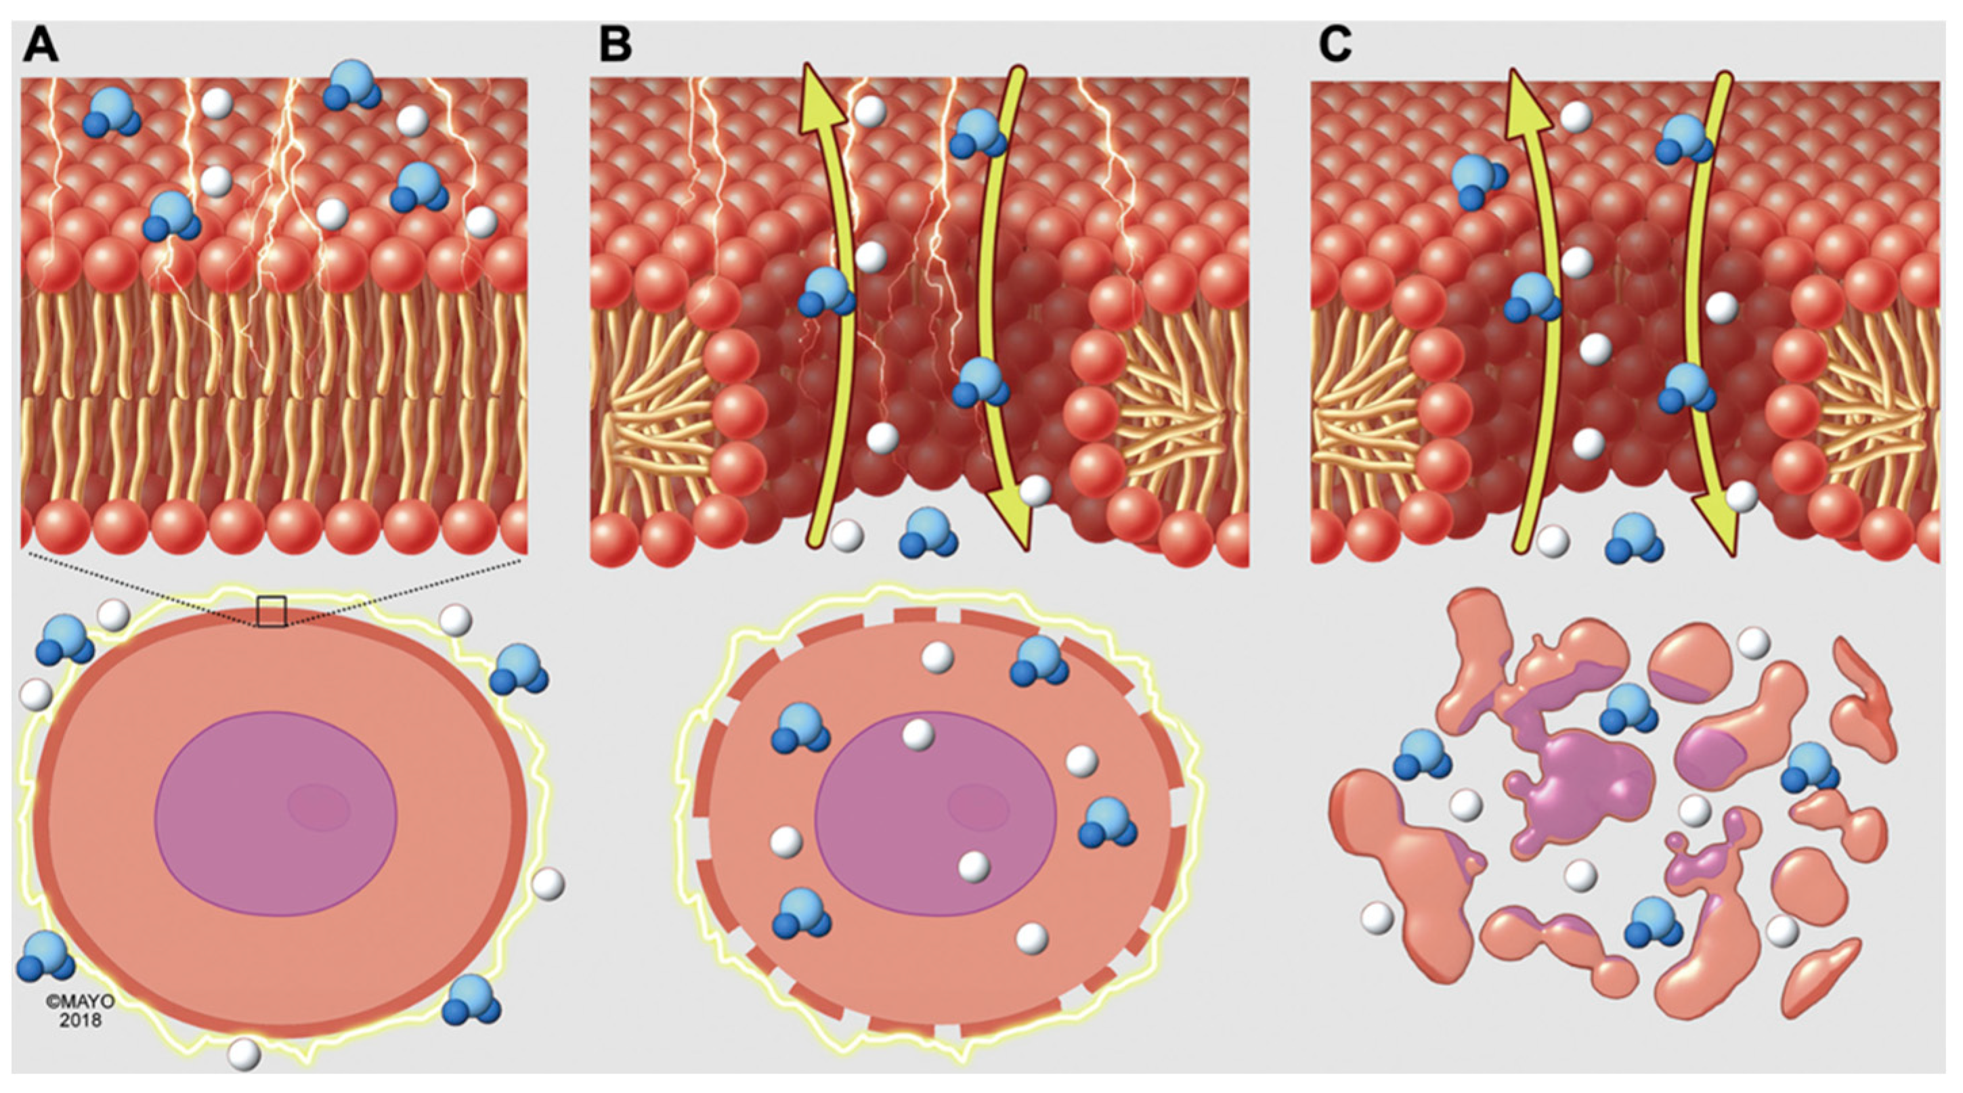
Pulse-Field Ablation (PFA)
Sullivan AP, Aguilar M, Laksman Z. Pulsed Field Ablation: A Review of Preclinical and Clinical Studies. Bioengineering. 2025; 12(4):329

Slide 33
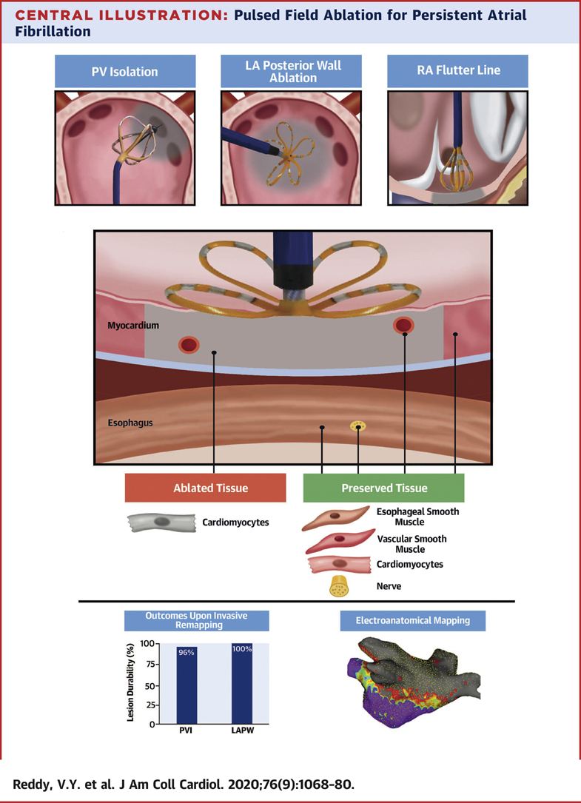

Slide 34
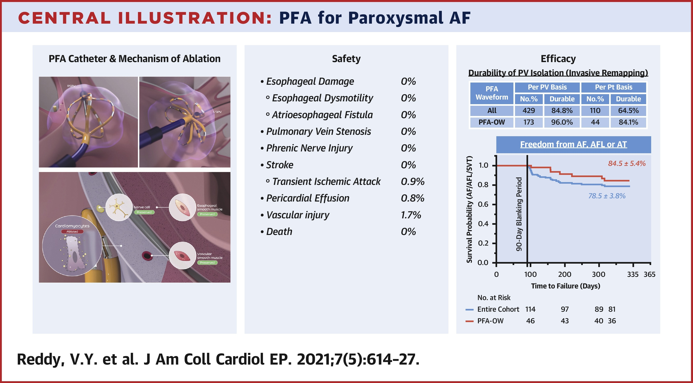

Slide 35
AF management
Anticoagulation is the most important treatment
Earlier ablation is better
PFA ablation is incredibly safe and efficient
Every typical atrial flutter can be cured

Slide 36
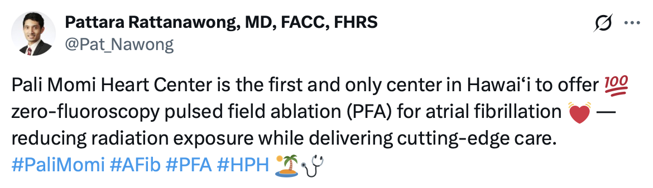
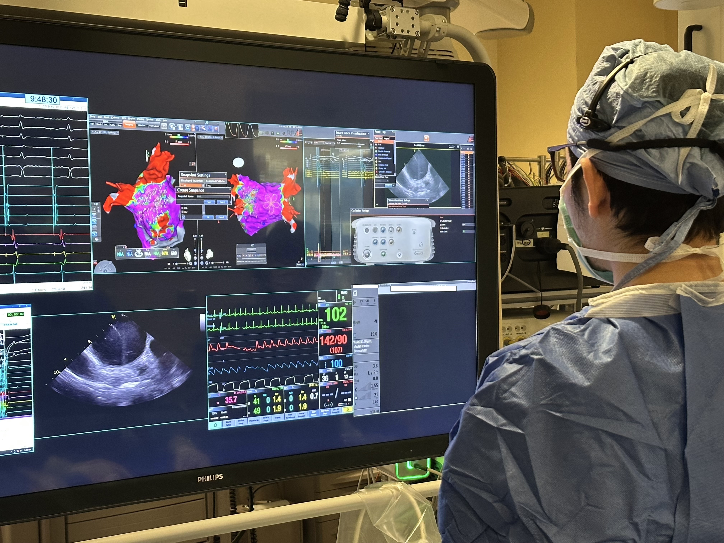
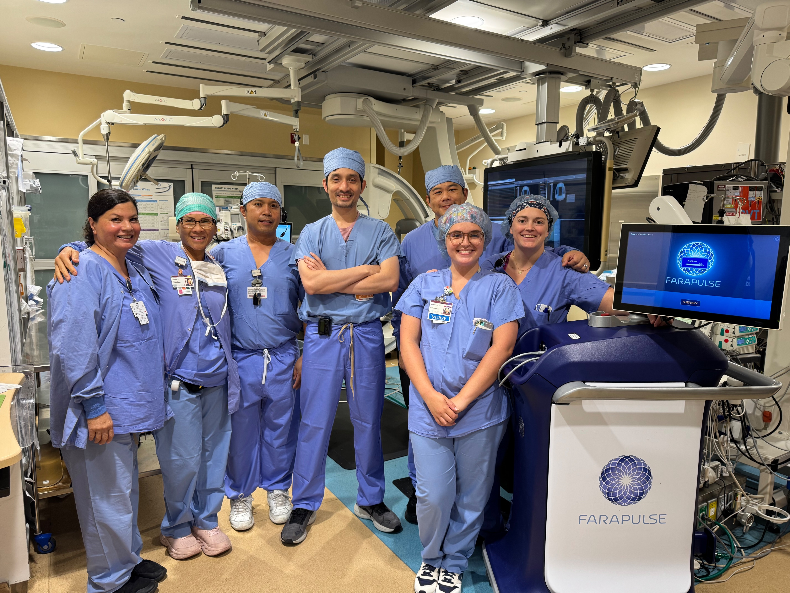

Slide 38

Thank you
808-859-3848
rattanawong.pattara@mayo.edu
pattara.rattanawong@hphmg.org
Twitter: Pat_Nawong

Slide 39
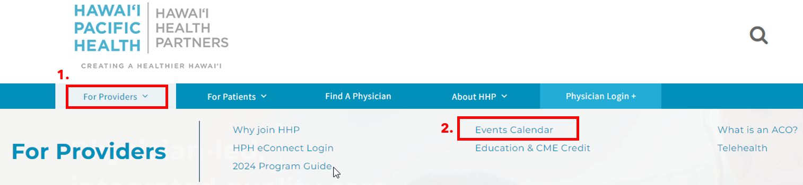
Next HHP Webinar (for HQIP credit):
^{No Webinar in July}
^{Next Webinar in August}
To view upcoming HHP webinars and future events, please visit our Hawai‘i Health Partners website for the “Events Calendar” from the “For Providers” dropdown.
Notes:
Abdominal Aortic Aneurysm

Slide 40
For All Providers: Provider Review Period: June 2 - 30
Final performance for the 2024 HHP QPP/SSP (now HQIP) is available.
Please review your 2024 dashboard and send discrepancies/inquiries to Info@HawaiiHealthPartners.org by June 30th.
Notes:
Abdominal Aortic Aneurysm

Slide 41
For Specialists Only (for HQIP credit) :
Annual Assessment of Chronic Conditions Presentation #1
Distributed on May 30th from Info@HawaiiHealthPartners.org
Deadline to view & answer test questions is Friday, June 27th
This measure is separate from HHP Network Engagement –Webinars
Notes:
Abdominal Aortic Aneurysm

Slide 42
Thank you for joining us!
A recording of the meeting will be available afterwards
Unanswered question?
Contact us at Info@HawaiiHealthPartners.org
Notes:
Finally, we thank you for your time this evening and for the tremendous amount of work that you have done over the last year to take care of our community. If you have additional questions, please reach out to us a

